Slide 1
Canvas Powering iLearn (A Sneak Peek)
Less time. Less effort. More awesome.

Slide 2
Canvas Goal
Canvas can make Teaching & Learning easier.
What can you do with Canvas?

Slide 3
Top 10 Coolest Features #1
Automated Tasks
Creating a new assignment automatically updates the gradebook, calendar, and syllabus
Everything is kept up-to-date and synced
Files repository allows you to share files between courses

Slide 4
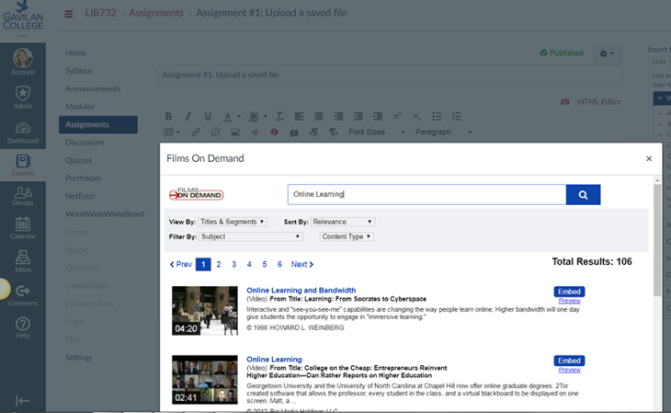
Top 10 Coolest Features #2
Multimedia Integrations
Films on Demand
YouTube
Flickr
Vimeo
Web Cam

Slide 5
Top 10 Coolest Features #3
SpeedGrader Annotations
Converts documents automatically
Annotations without download/upload
Multimedia feedback

Slide 6
Top 10 Coolest Features #4
Robust Course Notifications
Multiple Email Addresses
SMS
Facebook
Twitter
Etc

Slide 7
Top 10 Coolest Features #5
Drag and Drop
Canvas allows the user to organize their course materials use the drag and drop functionality
Files
Modules
Calendar events
Assignments
Etc…

Slide 8
Top 10 Coolest Features #6
Bulk download and upload
Use external tools or need to work offline?
You can use the zip feature to download files from your course then upload when ready.

Slide 9
Top 10 Coolest Features #7
Ease of Use
Mobile Friendly
Accessible
Clean
Intuitive

Slide 10
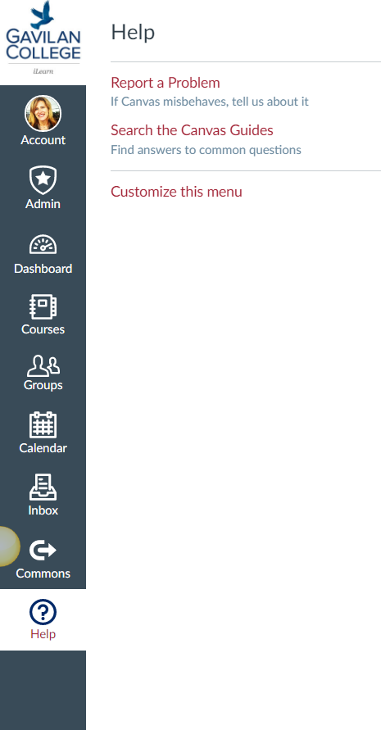
Top 10 Coolest Features #8
Help Center
Use the Help button located in the user navigation left hand menu. The Help button links directly to several helpful Canvas resources.
The Community – Keep up to date on Releases (3 weeks) –and a host of Community Forums = Awesome!

Slide 11
Top 10 Coolest Features #9
Integrations
Turnitin
Potfilium
NetTutor
MyLabs
CCCCO vetted Student Support tools
Many more options

Slide 12
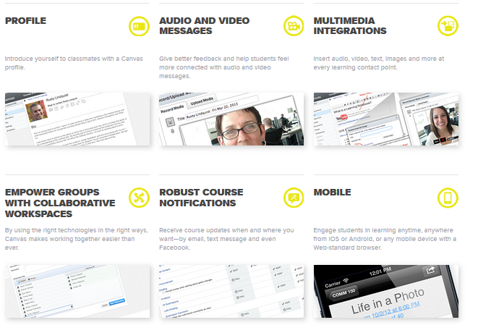
Top 10 Coolest Features #10++++

Slide 13
Getting Started
Dashboard
Designed to answer what is going on with all my classes?
Sidebar
Contains 3 helpful feeds. Coming Up, To do, and recent feedback
Main Navigation
This bar will always be available.
Help
Help is always just a click away.

Slide 14
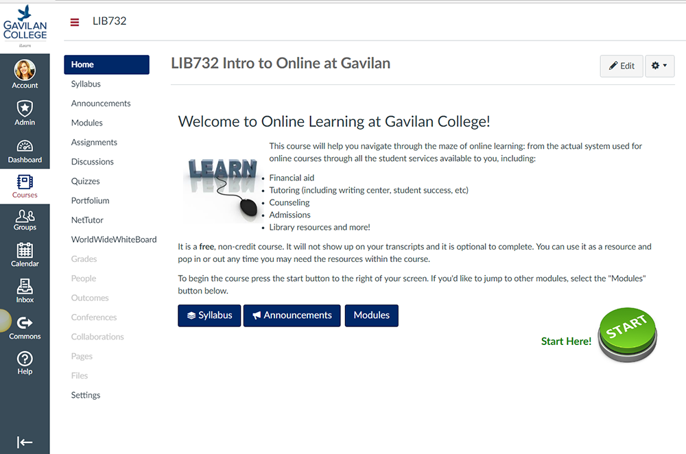
Canvas - 7 Main Sections

Slide 15
Using Canvas for SLO’s
Why use Canvas?
Measure course outcomes with rubrics aligned to assessments.
Collect SLO data as you assess your students.
Import program and institutional outcomes.
Use analytics
Export your outcome reports

Slide 16
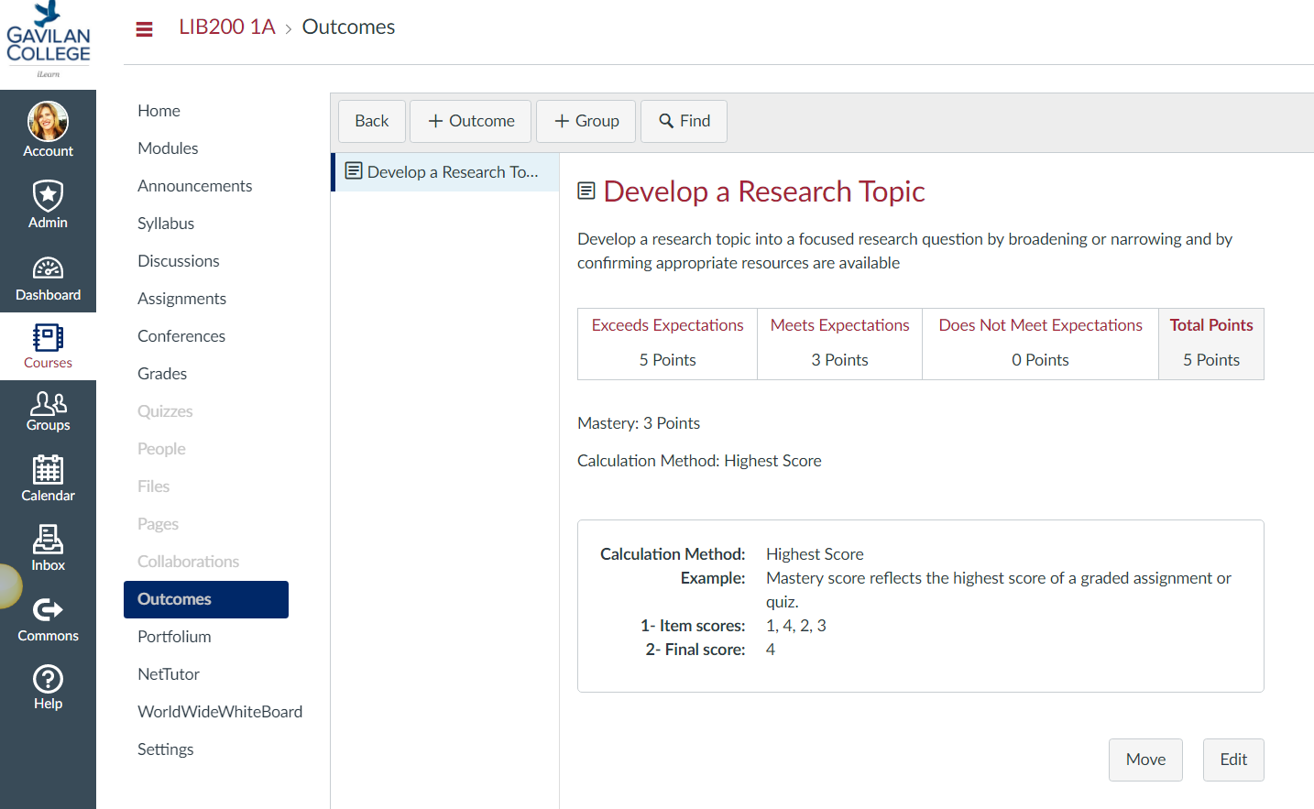
Using Canvas for SLO’s
Outcomes
A first look
Course level outcomes
And BTW – thanks Aloha Sargent for the images and examples from your course!

Slide 17
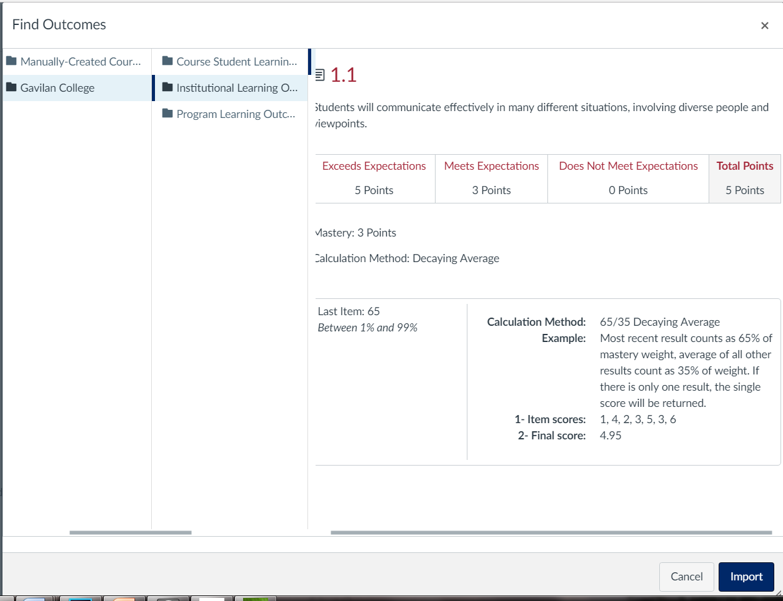
Using Canvas for SLO’s
Outcomes
Institutional

Slide 18
Using Canvas for SLO’s
Rubrics
One rubric for many assignments
Department level rubrics
Attach PLO’s/SLO’s/ILO’s
…And what about those GE – LO’s, folks?
Assignment outcomes
Attached SLO
Notes:
Show in speed grader too

Slide 19
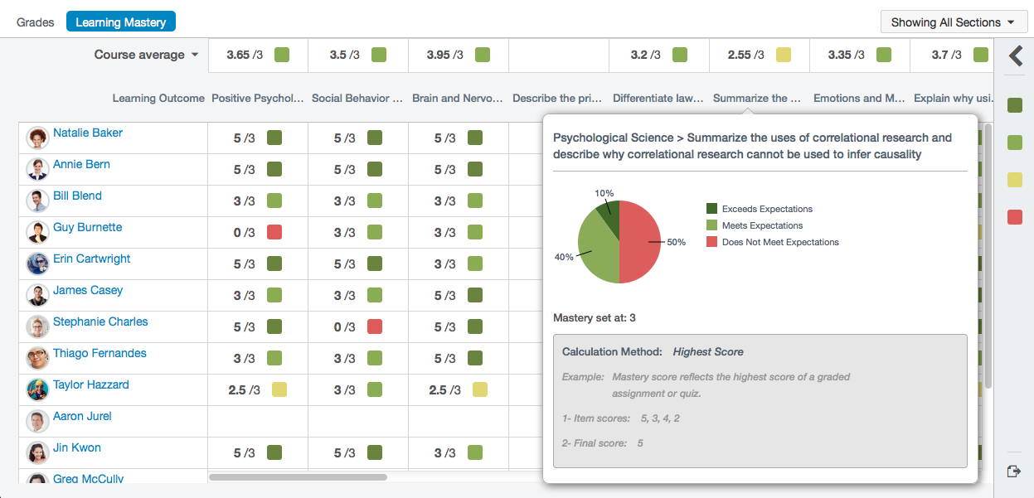
Using Canvas for SLO’s
Student Learning Mastery
Oh! The data you will have.

Slide 20
Using Canvas for SLO’s
Ready to Play? Choose one of your courses and use the following resources:
my.gavilan.edu>intranet>course outlines
(find your course outline, will have SLO, PLO’s and ILO’s listed)
Go to: instructure.gavilan.edu
Will take you to your Canvas dashboard will you will see a sandbox course for SP17 – (except pilot courses)
See our instructional website at http://www.gavilan.edu/staff/tlc/tech_help/outcomes.php
See Canvas guides for step by step instructions.
Video tutorials here:
Outcomes: https://community.canvaslms.com/videos/1638-outcomes-overview-instructors
Rubrics: https://community.canvaslms.com/videos/1518-rubrics-overview-instructors
Text how-to’s here:
https://community.canvaslms.com/docs/DOC-4131#jive_content_id_Outcomes
https://community.canvaslms.com/docs/DOC-4131#jive_content_id_Rubrics

Slide 21
Distance Education Department
Sabrina Lawrence
Distance Education Coordinator
disted@gavilan.edu
408 848-4885
Peter Howell
Distance Education Trainer
disted@gavilan.edu
408 848-4885
Location:
Teaching and Learning Center
Physical: Upstairs in the Library
Virtual: http://www.gavilan.edu/student/online/
http://www.gavilan.edu/staff/tlc/

