Slide 1
BUDGET UPDATE
BUDGET DEVELOPMENT
Vice President of Administrative Services
FY19/20
FY20/21
August 17, 2020

Slide 2
GAVILAN’S FY20
GENERAL FUND PROJECTIONS
(This Year)

Slide 3
YEAR-END CLOSE FY20
Still in progress:
  Month End Close
  Year End Close
  Position Control
  Begin Tentative Budget Development Process Day On After Final/Adopted Budget
Monthly Projections
  Earlier the better
  Time to navigate
Bond Ratings

Slide 4
GAVILAN’S FY21
BUDGET DEVELOPMENT
(From Tentative Budget To Adopted/Final Budget)

Slide 5
FY21 Budget Items – Proposed
Full Board:
July Board –
  Adopt next TRAN: Est: $10M
  July: Banner Migration to Cloud (Measure X Project)
  South Bay Academy JPA – Facility Use Agreement
  Golf Course Facility Use Agreement
September Board—
  Complete negotiations – minimize impacts using remaining FY21 months
    CSEA 90% Completed
  Adopted Budget – Target 8 September (normal deadline 30 Sept)

Slide 6
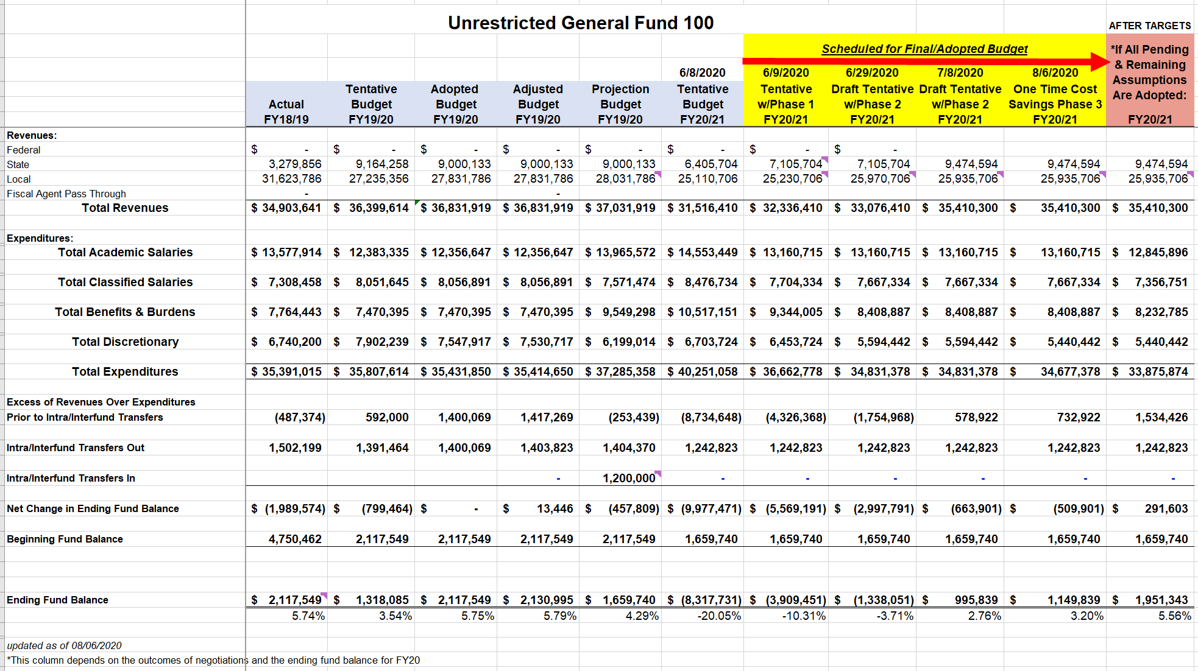

Slide 7
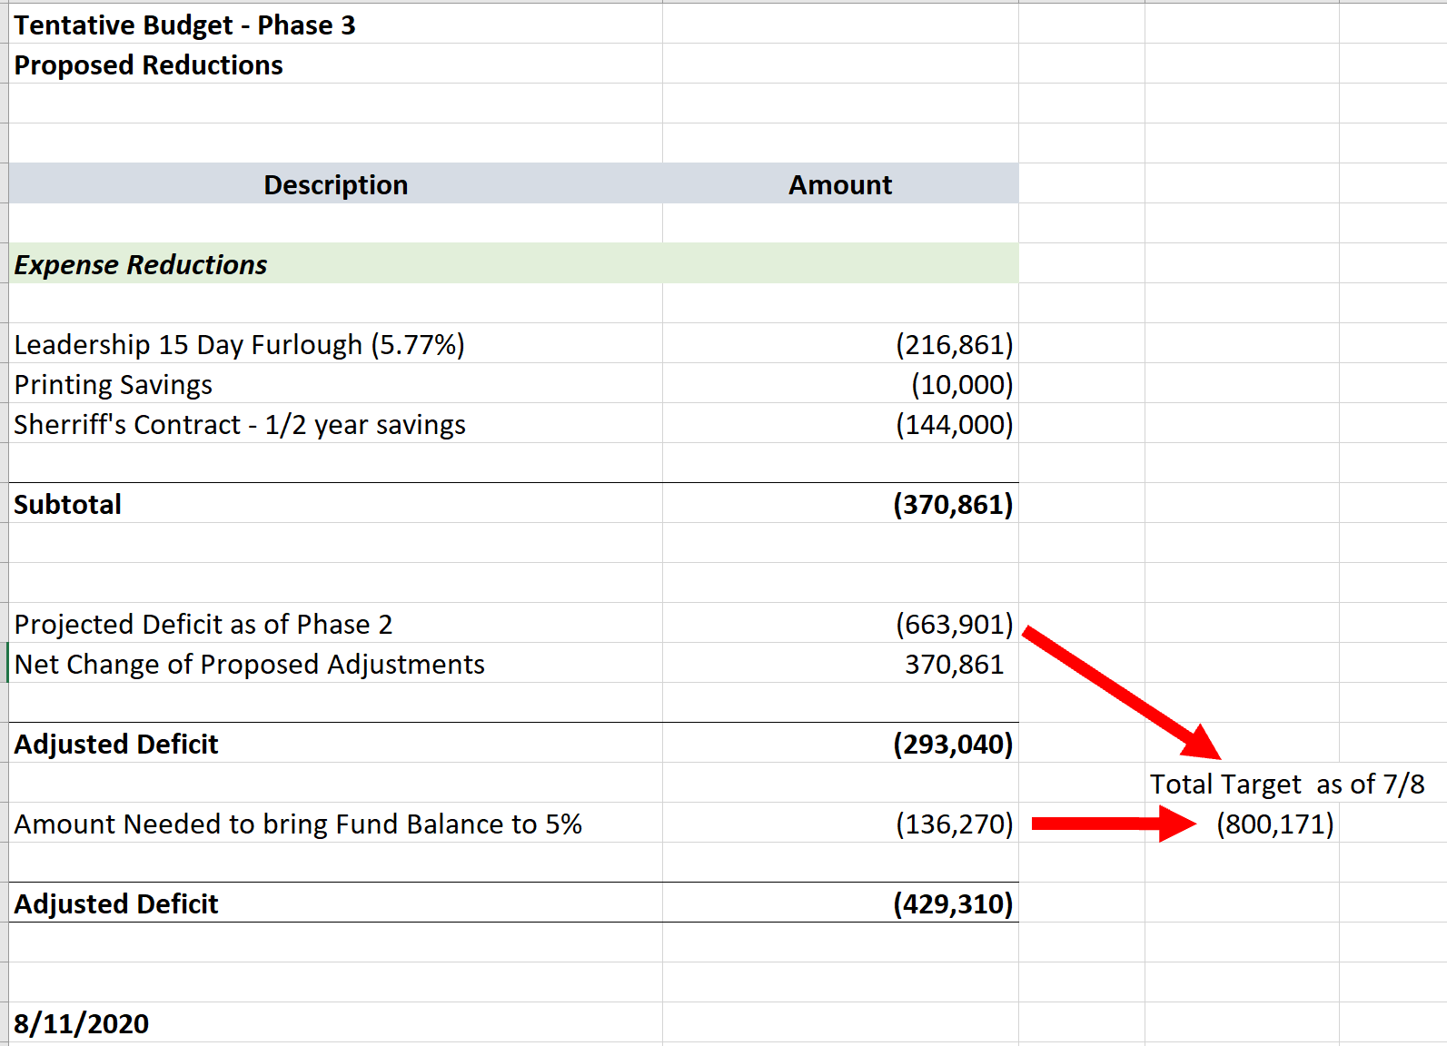

Slide 8
FOOTNOTES

Slide 9
SLIDES FROM AUGUST 2020 (& PRIOR)

Slide 10
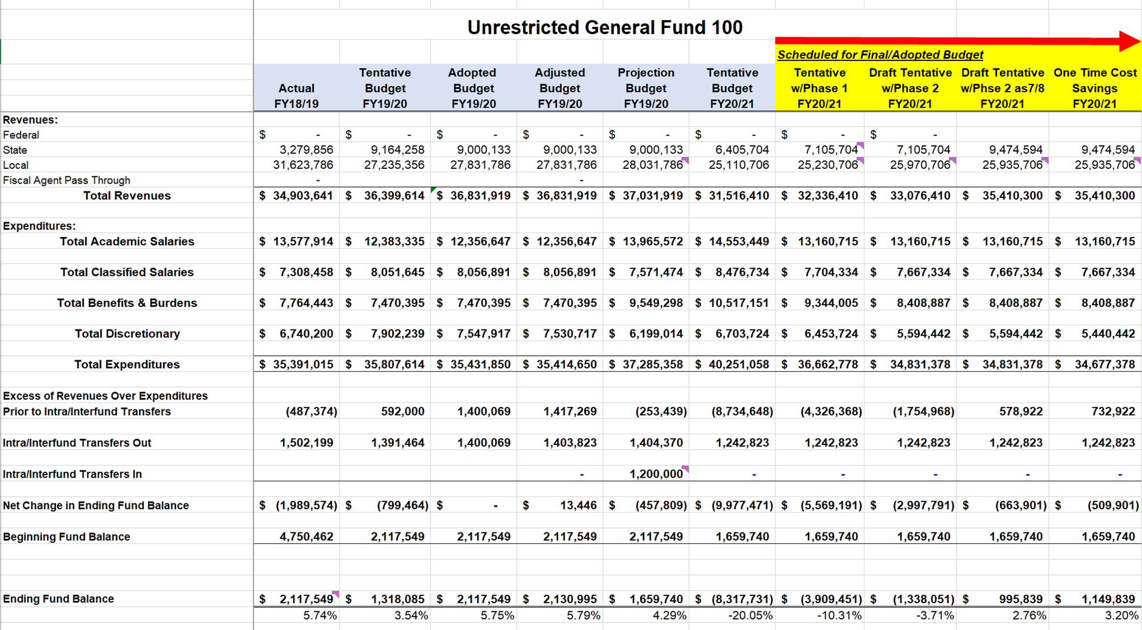

Slide 11
SLIDES FROM JULY 2020 (& PRIOR)

Slide 12
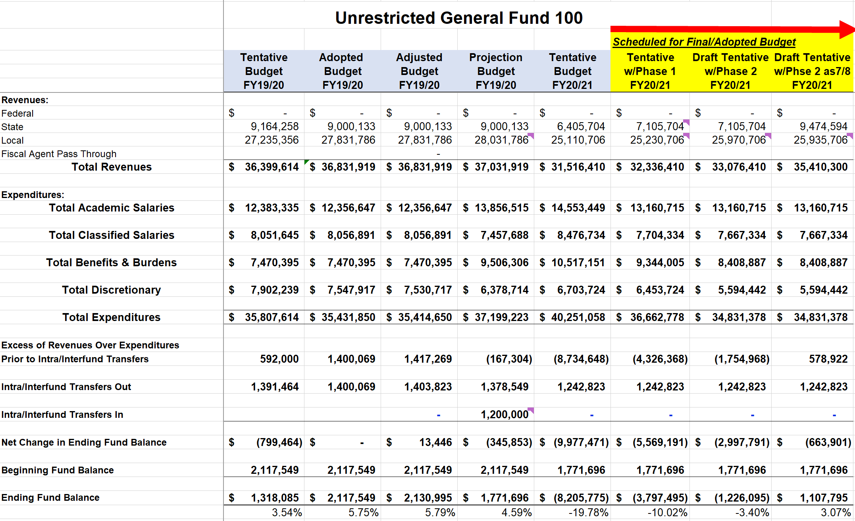

Slide 13
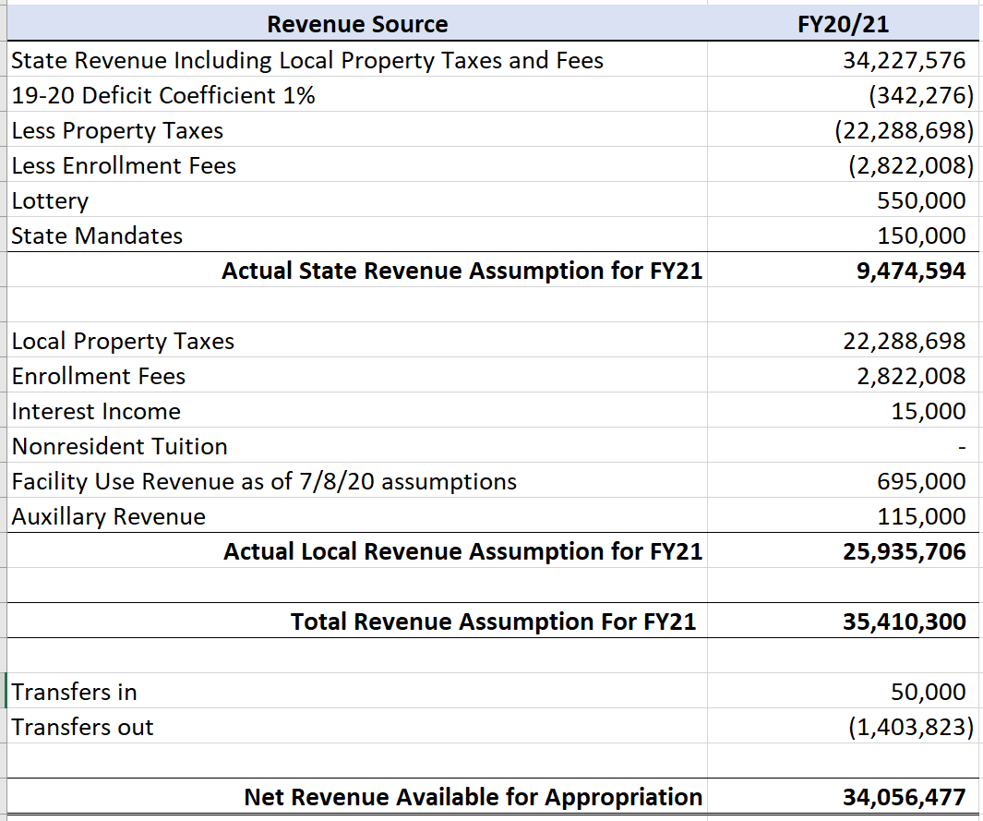

Slide 14
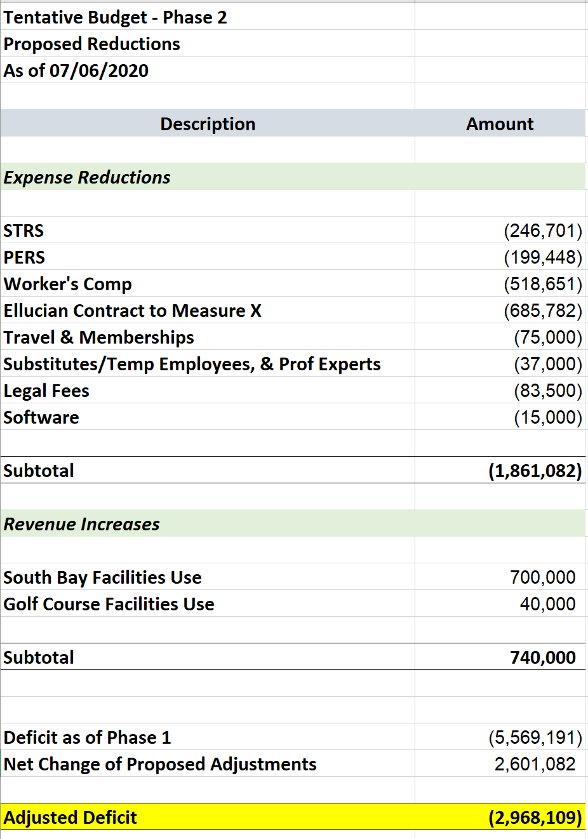

Slide 15
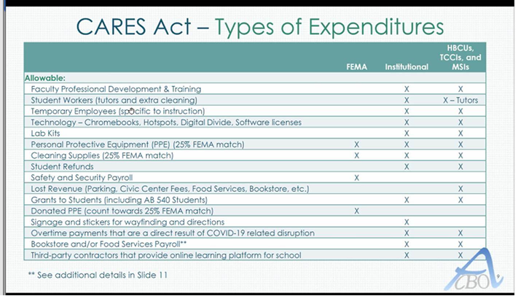

Slide 16
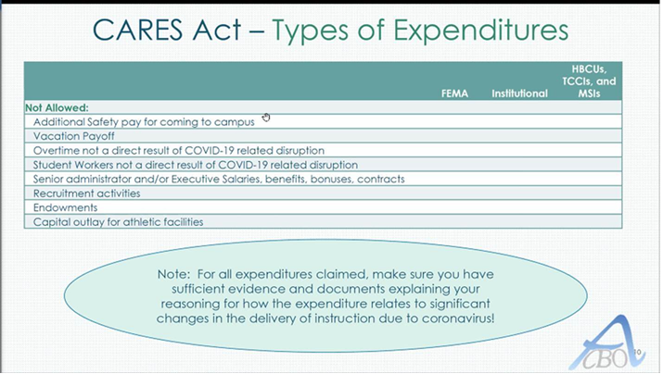

Slide 17
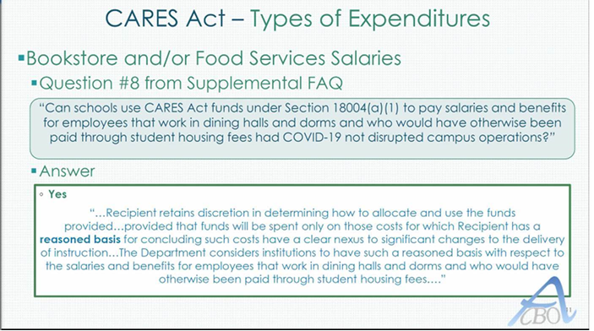

Slide 19
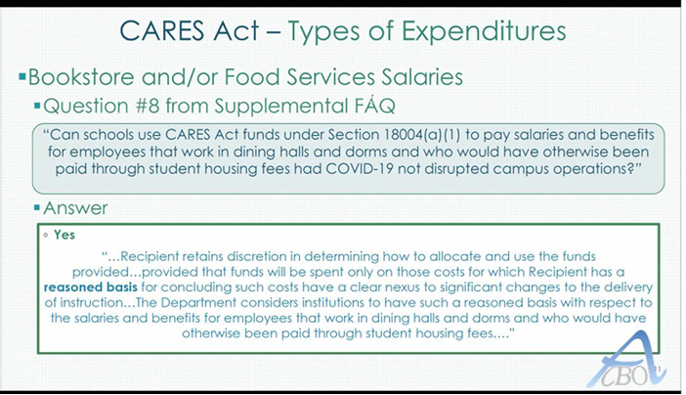

Slide 20
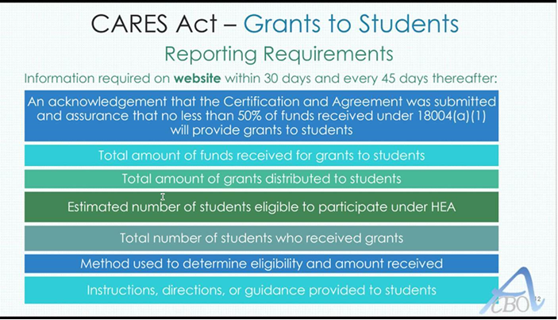

Slide 21
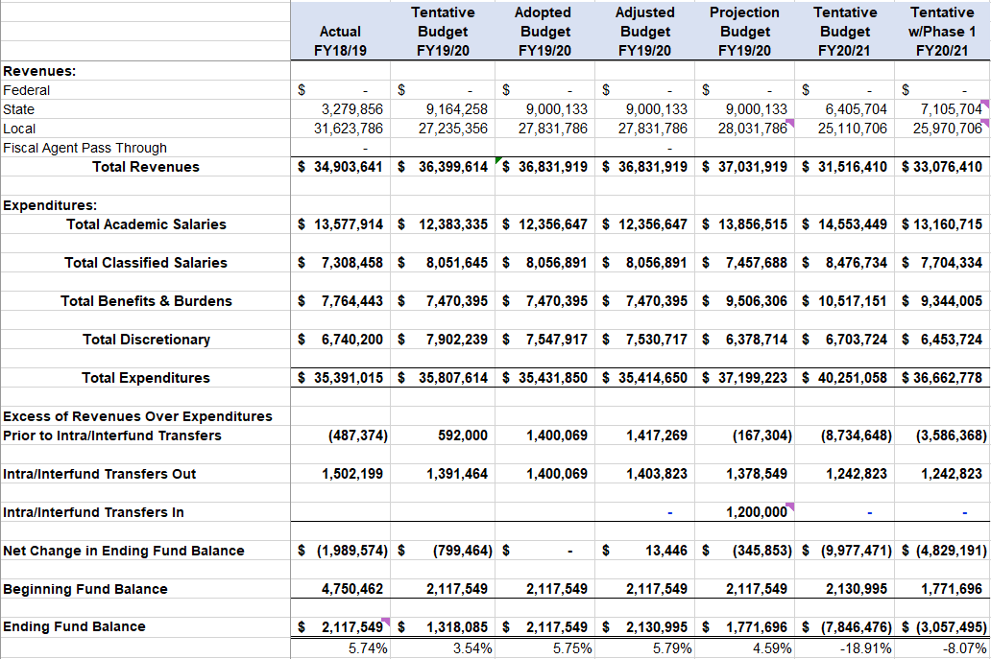
After Board Adoption Of Tentative Budget 6/9/20
Post Phase 1

Slide 22
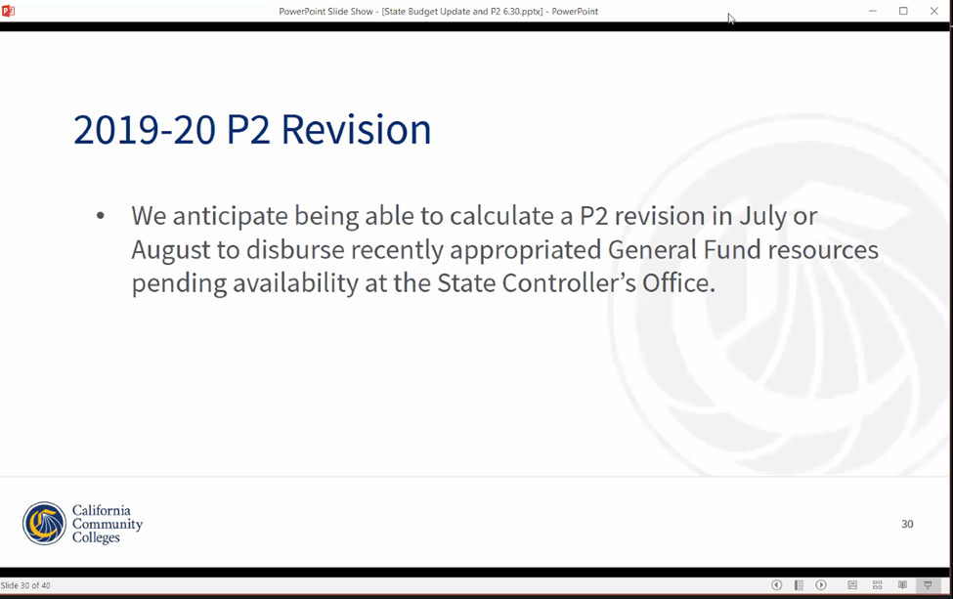

Slide 23
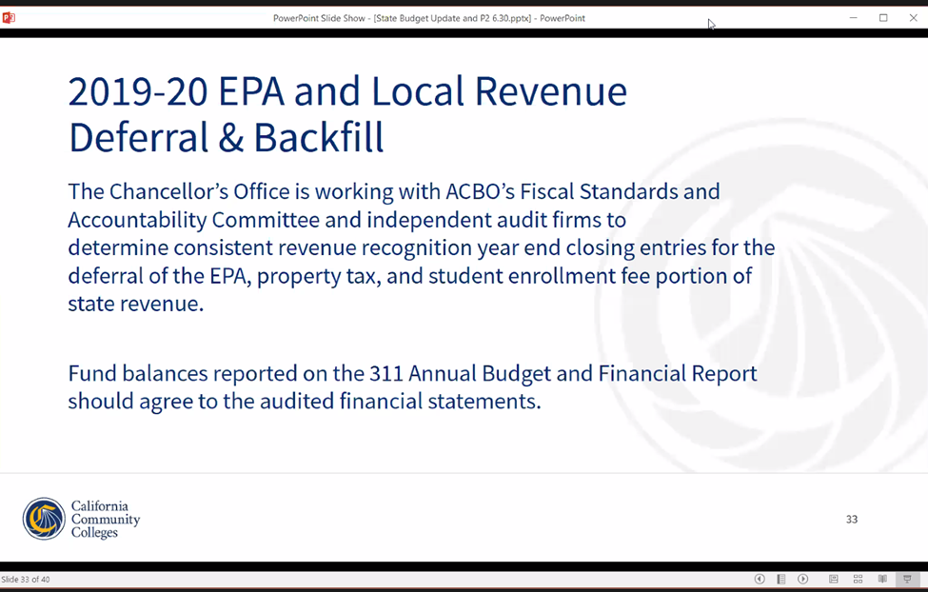

Slide 24
Prior to 7/6/2020
After Board Adoption Of Tentative Budget 6/9/20
Post Phase 1

Slide 25
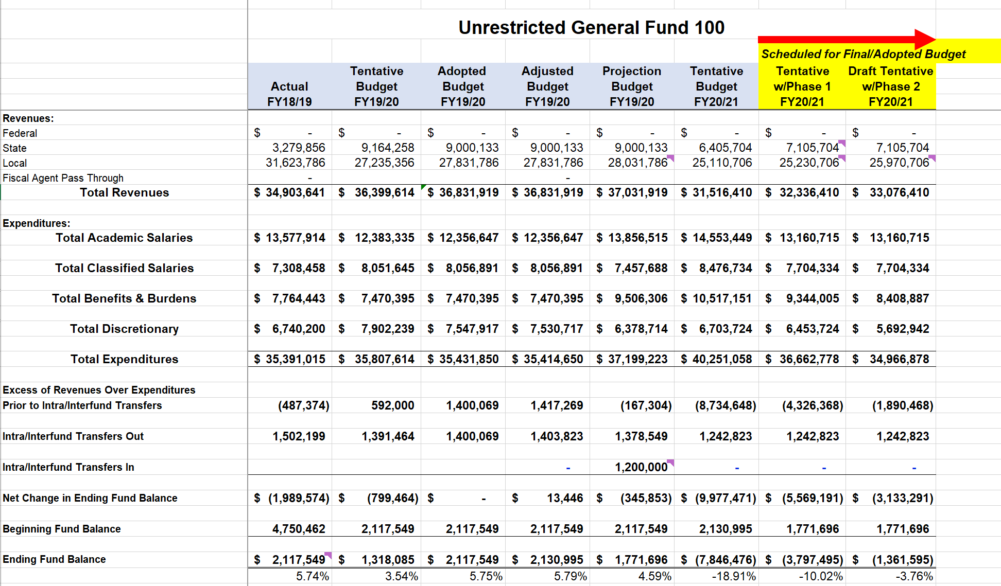

Slide 26
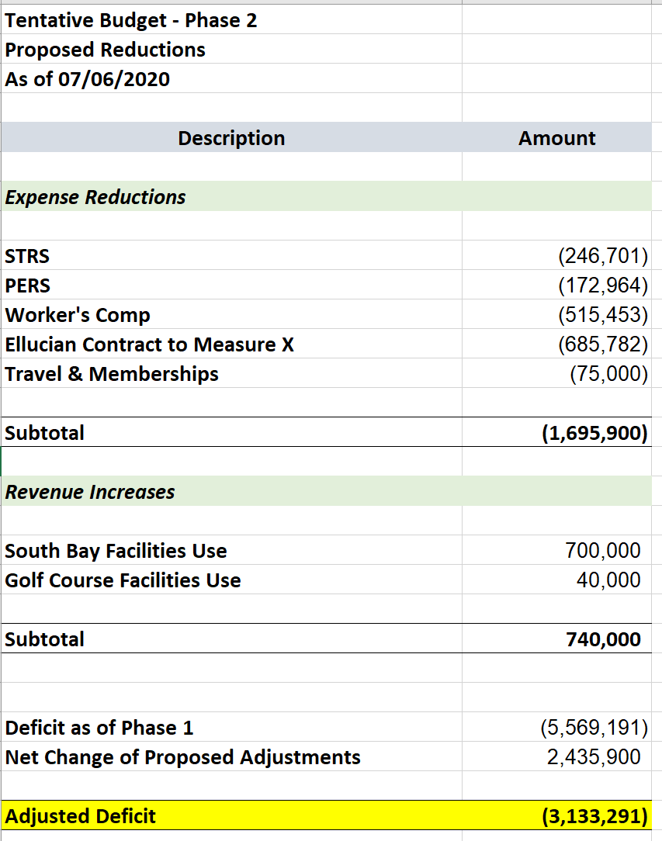

Slide 27
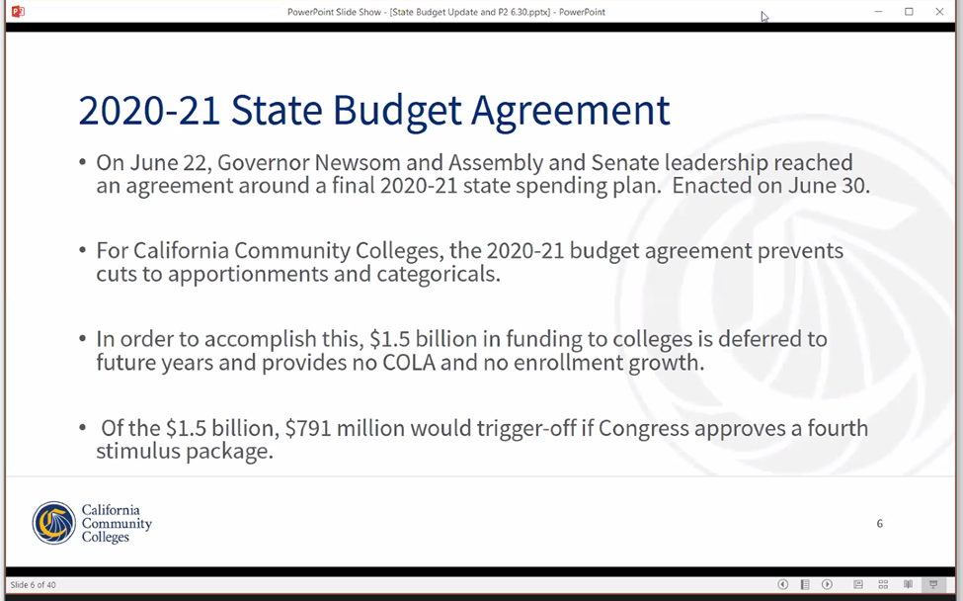

Slide 28
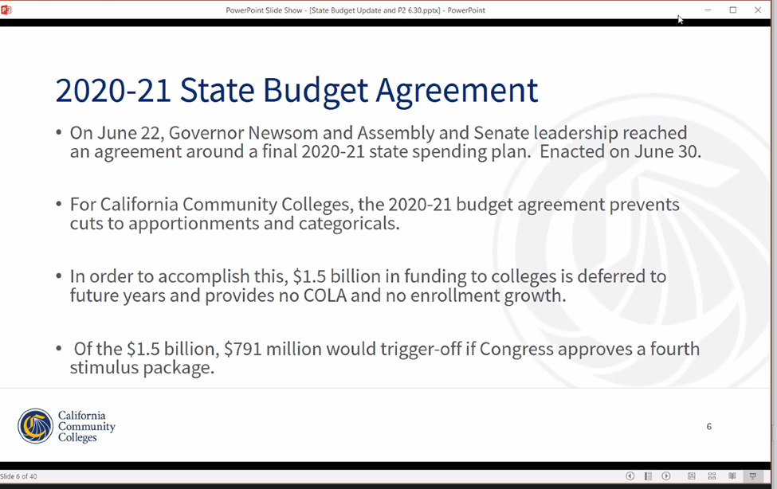

Slide 29
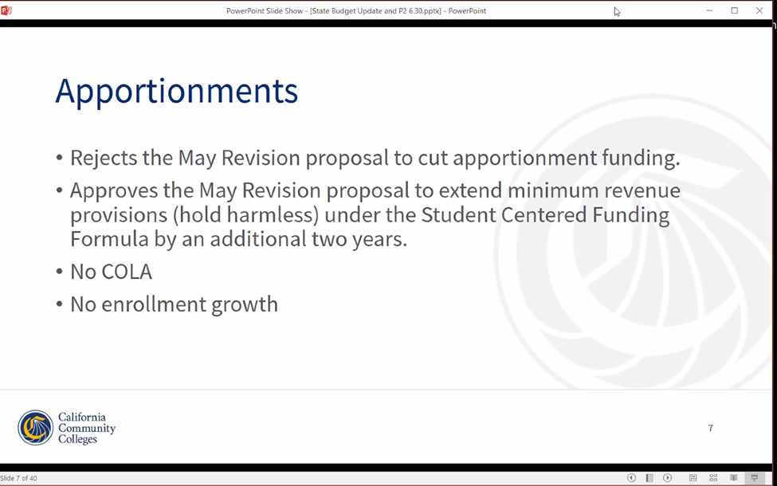

Slide 30
Apportionments -
Rejects the May Revision proposal to cut apportionment funding.
Approves the May Revision proposal to extend minimum revenue provisions (hold harmless) under the Student Centered Funding Formula by an additional two years.

Slide 31
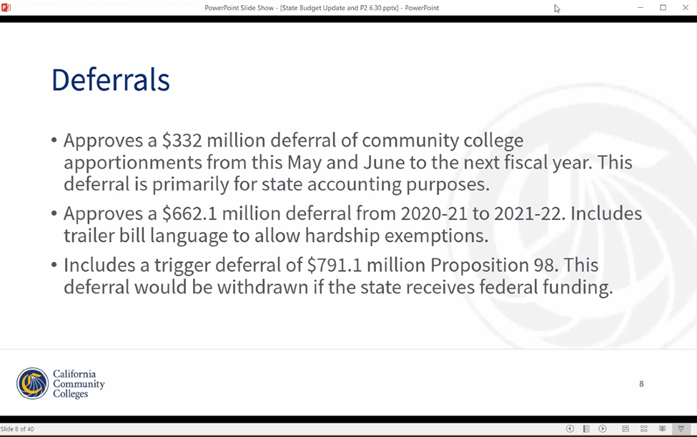

Slide 32
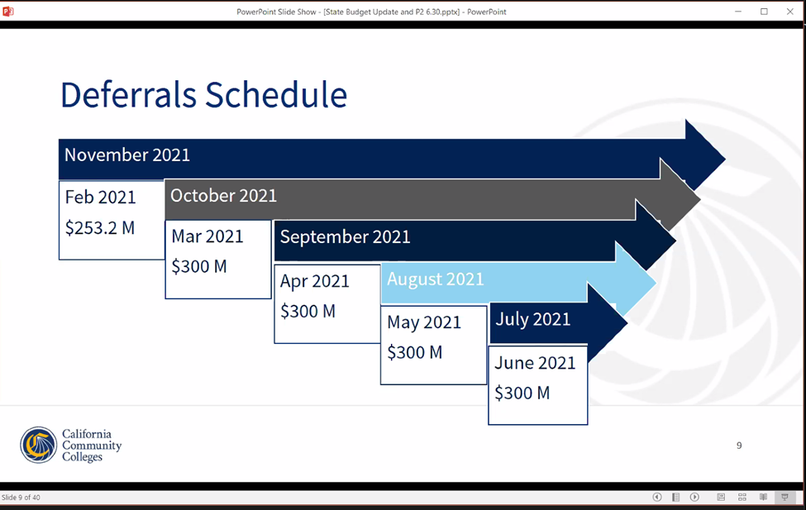

Slide 33
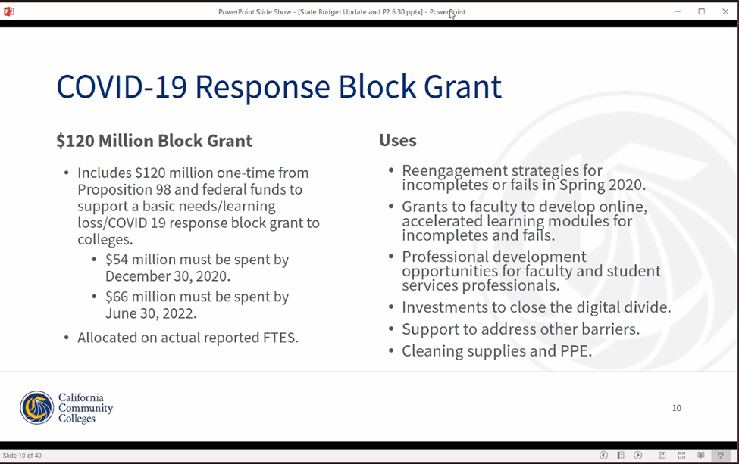

Slide 34
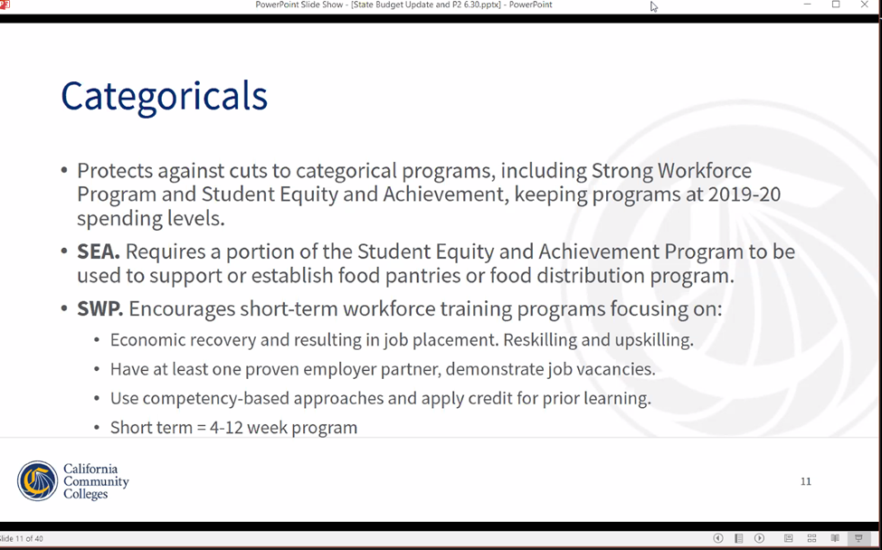

Slide 35
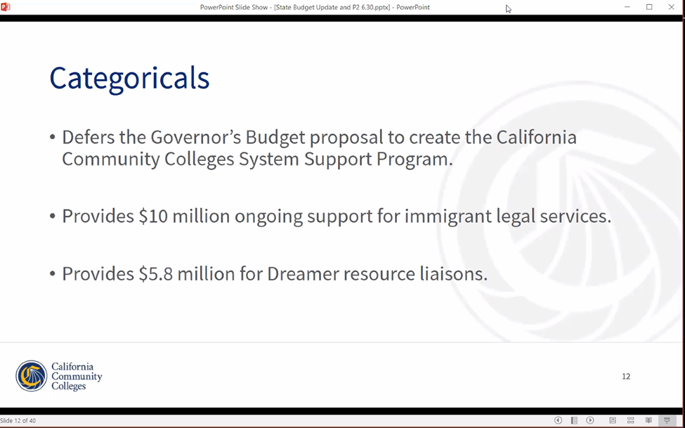

Slide 36
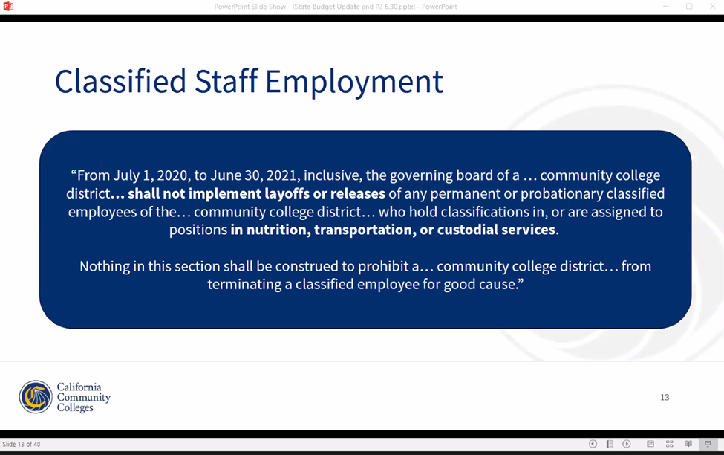

Slide 37
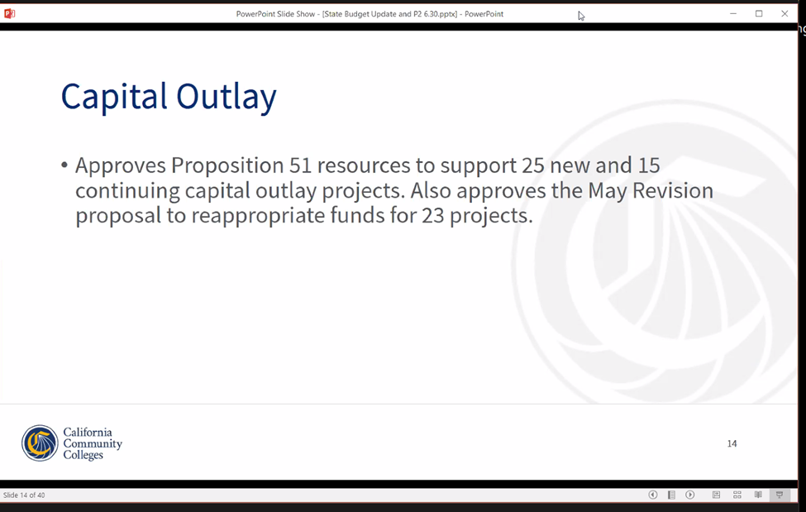

Slide 38
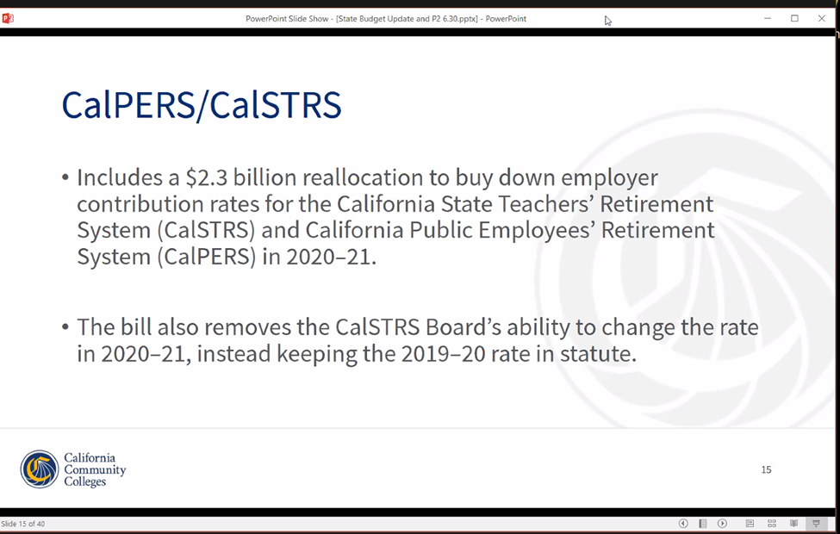
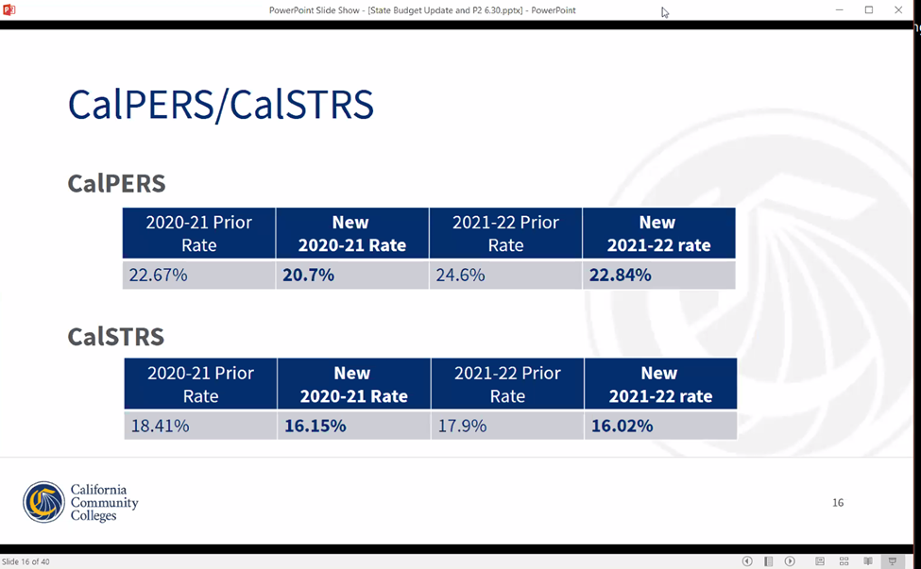

Slide 39
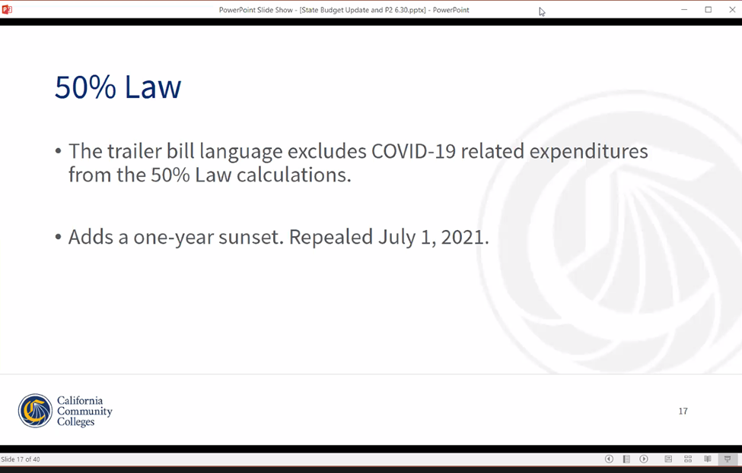

Slide 40
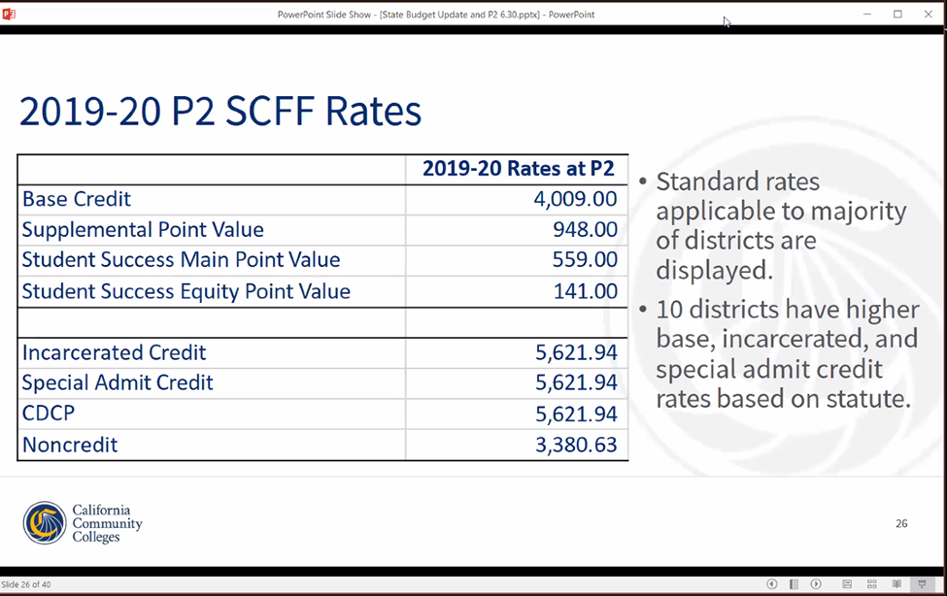

Slide 41
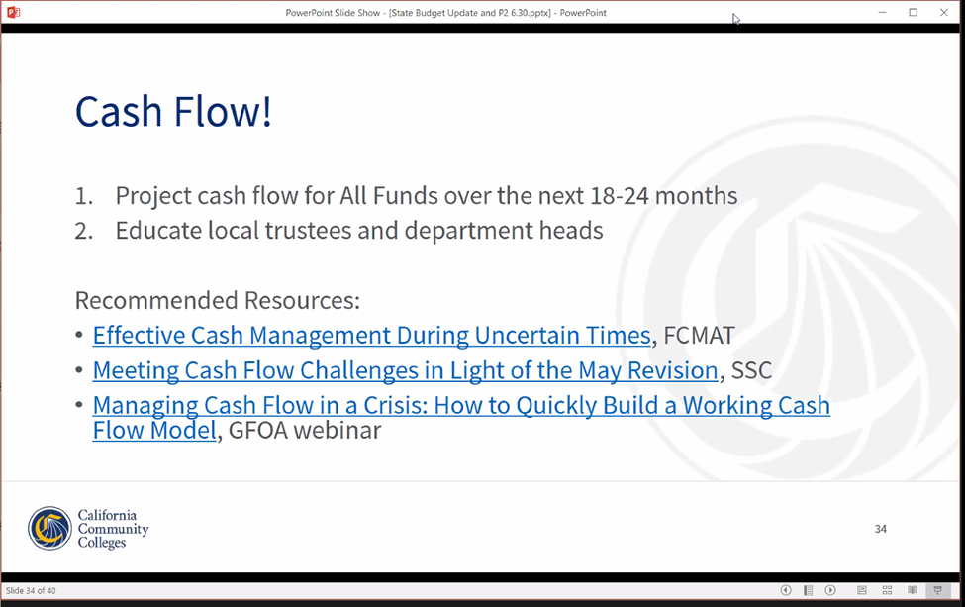

Slide 42
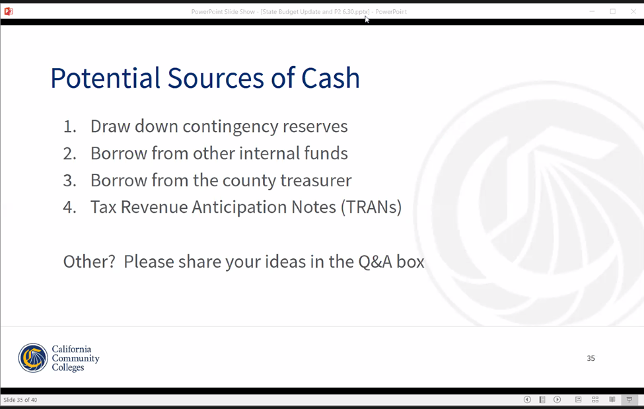
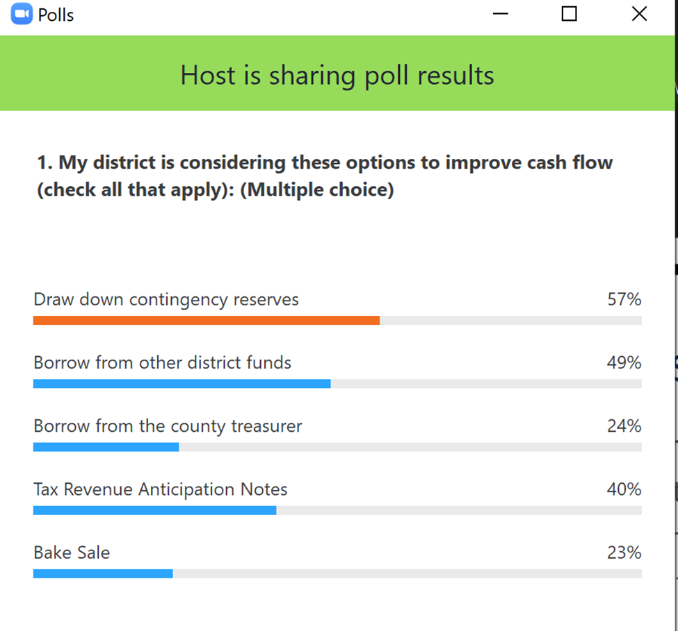

Slide 43
Why Banner/ERP Modernization?
Procured Banner with Measure E-> Modernize in Measure X.
Data compliance with Federal Financial Aid (Oct 2020), State Reporting & Federal Reporting, and District’s Financial Systems.
Current in-house servers are unsupported & antiquated.
Cloud-base has business continuity & protection.
Standardization of version updates (CCCCIS).
Disaster Recovery meets Standard 3(c) of ACCJC recommendation.
SIG will help with the implementation / testing.

Slide 44
Implementation Costs & First Year
IMPLEMENTATION YEAR: First Year: $1,131,021 (Measure X)
OPERATIONAL YEARS: Second Year & onward: exercise incentive credits ($211K) towards future annual costs within the operating budget.

Slide 45
Next Steps:
Guidance On:
  Prepare for est. $10M TRAN for Cash Flow to General Fund
  Prepare Measure X Issuance for Next Set of Projects (San Benito Campus & Data Infrastructure)
  Sheriff Department Contract
Post FY21 Tentative Budget (Adopt Budget development):
  Apply July 8th ACBO Assumptions & Analysis to Revenues
  Apply Phase 2 Reductions to Expense Budget Assumptions
  Review Phase 3 with campus community

Slide 46
SLIDES FROM JUNE 2020 (& PRIOR)

Slide 47
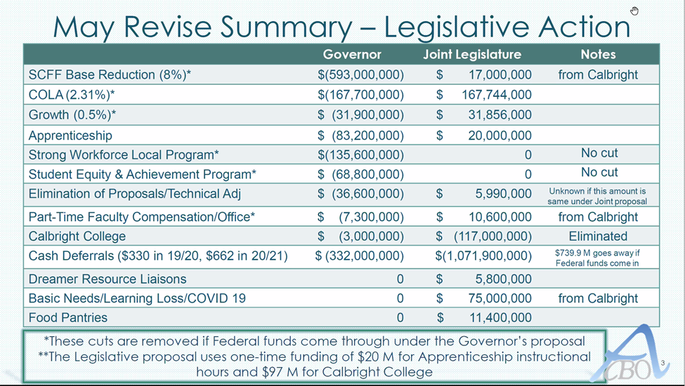

Slide 48
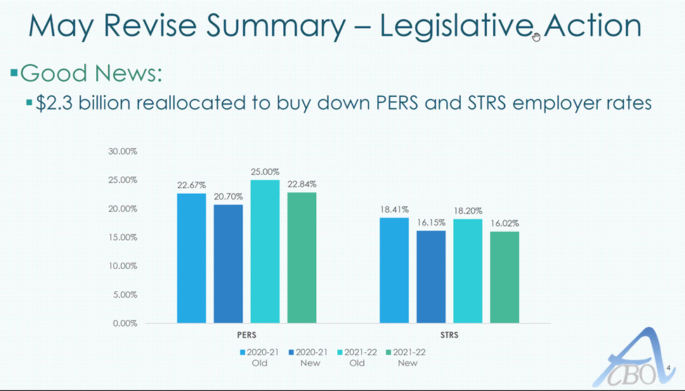

Slide 49
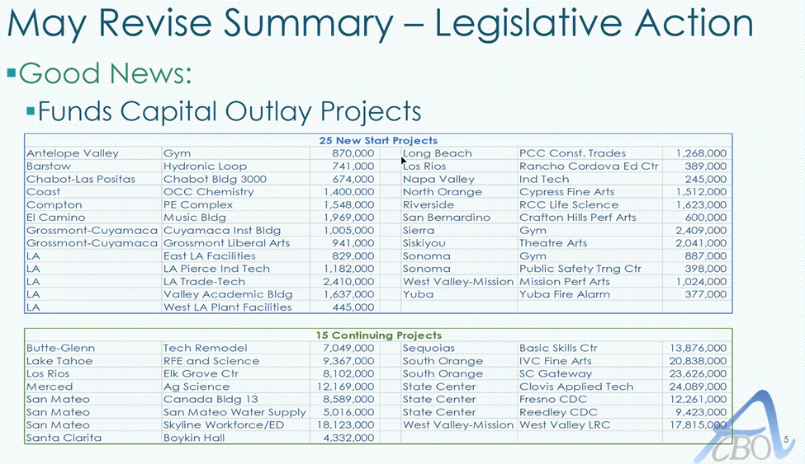

Slide 50
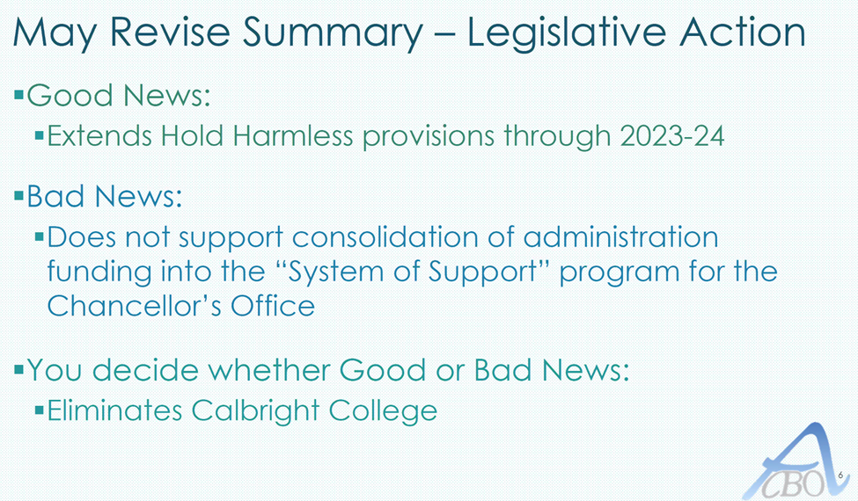

Slide 51
Calbright College Uncertainty
Legislature is proposing to eliminate Calbright College, if Governor approves. Dec 20/21 to closure depending on strategy. Unclear whether the funding allocated to CC would be reallocated to rest of the CCCs or the plan to reduce the deficit. May not see funding result until FY22.

Slide 52
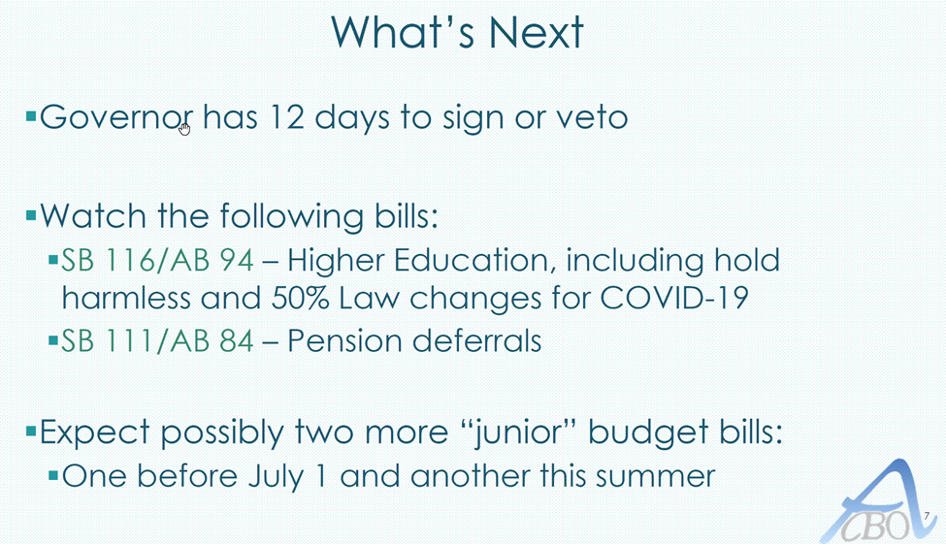

Slide 53
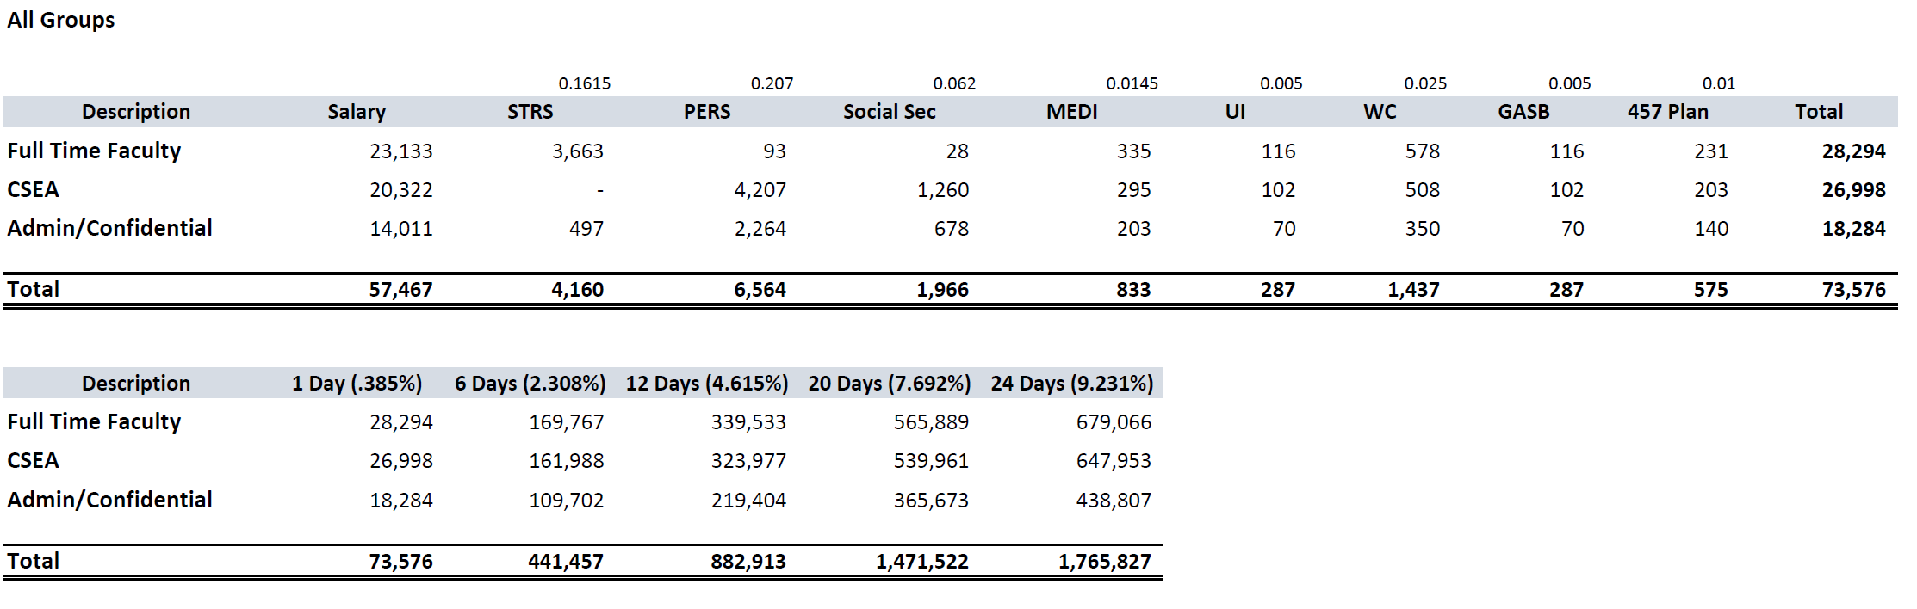
Preparing for Phase 2/3

Slide 54
Other ACBO / CCCO “Head’s Up”
Currently on P2 and should be done by the end of the month What is the projected deficit? Still don’t know but P1 gaps closed by P2 so that likely less than 1%. Trying to figure out the impacts due to EPA delays. While some of the deferral of taxes may be in effect, the budget will still backfill that gap this year. Student enrollment and property taxes are up.
Preliminary injunction of the CARES Act – we are able to provide funding to students that were originally excluded in Title 4. More details TBD on how to allocate. There will be more flexibility but the intent of the law should still be followed.
CCCO about “policing on campus”? – need to structure on campuses.
Legislature seeks that --All trailer bills done before June 30 – result? FY21 would be set, then may need more TRANs bc of the deferrals. There is some rumor about have additional block grants due to COVID-19.
Concerns that unemployment costs to districts may occur of a bill for 50% of the $600 per week COVID/CARES act due unemployment. From Kathy Blackwood to Everyone: 03:43 PM
This website suggests that states can't charge employers for the CARES act $600: https://www.natlawreview.com/article/us-dol-issues-additional-guidance-cares-act-unemployment-programs

Slide 55
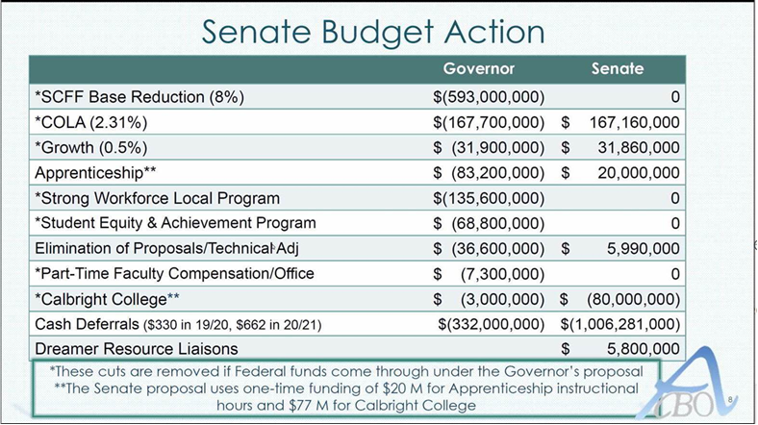

Slide 56
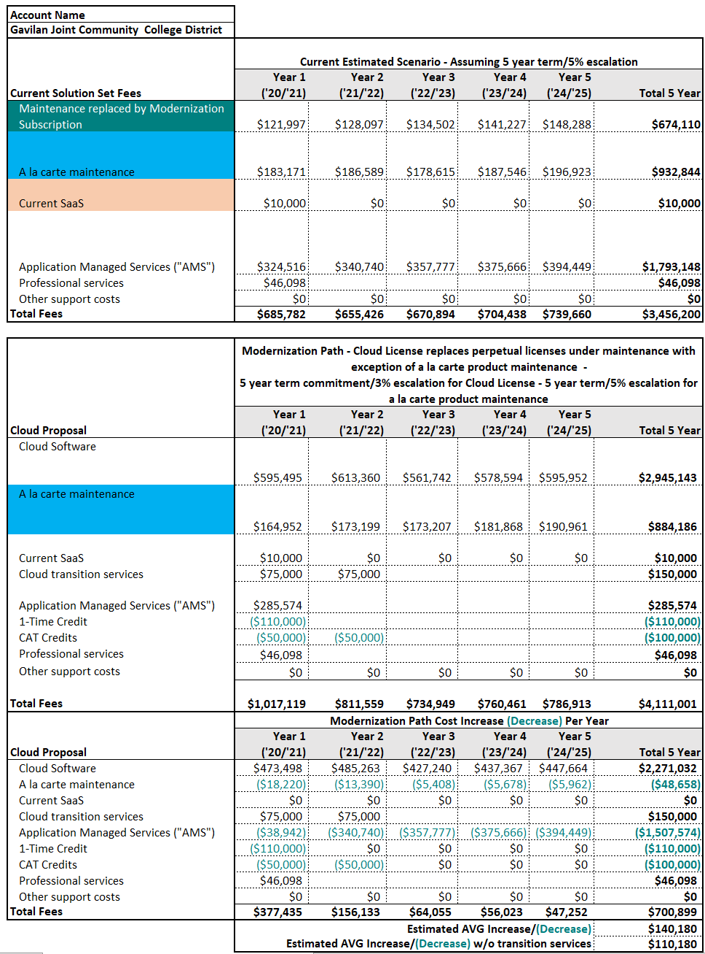
Future Costs After Implementation
(FY22 and Beyond)
→ IMPLEMENTATION YEAR: total Year 1 $1,131,021
(Measure X)
→ OPERATIONAL YEAR: Year 2 onward: exercise incentives as we integrated annual costs within the operating budget.

Slide 58
Athletics – Modified Season
CCCAA Coronavirus Planning
20/21 – Season Competition
Student Enrollment Impact: On average
  12.6 Units Per Student @ 154 Student Athletes
  Impacts SCFF
  Promise
  Vision for Success / Equity / Access

Slide 59
SLIDES FROM MAY 2020 (& PRIOR)

Slide 60
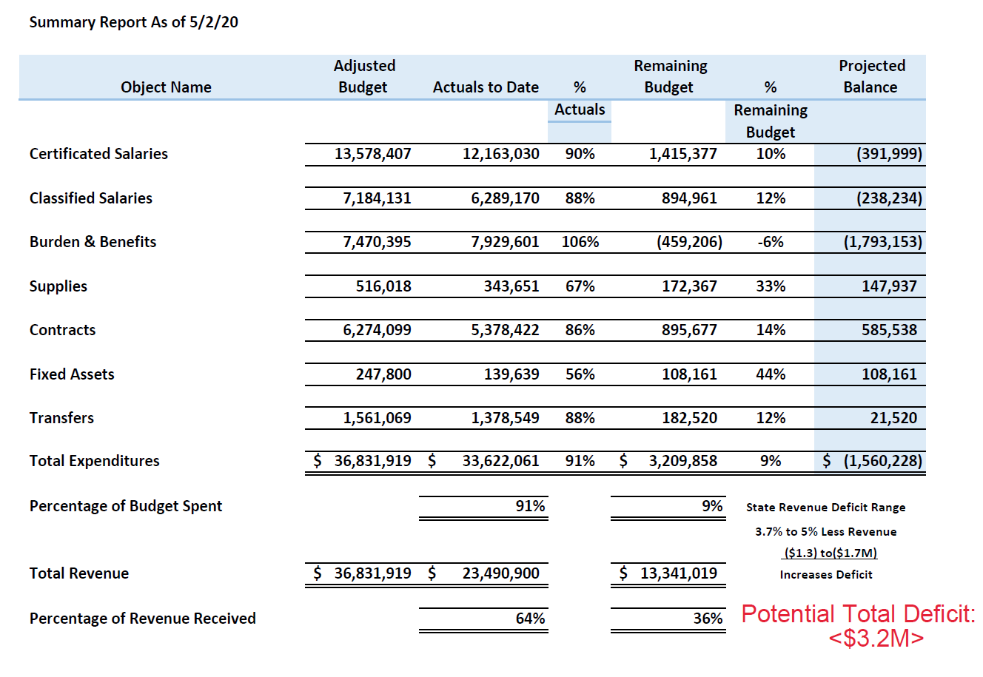

Slide 61
Tentative Budget Assumptions / Changes
FY21: Tentative Budget (Subject to Change in August 2020)
  Defund Vacant Positions - $2.2M
  CV Joint Facilities Use - $700K
  MH Lease - $250K
  Sheriff Contract - $288K
  Other Operational Costs – ($150K - $TBD)
Unknowns: What will be the new base funding for SCFF and State Workload allocation?

Slide 62
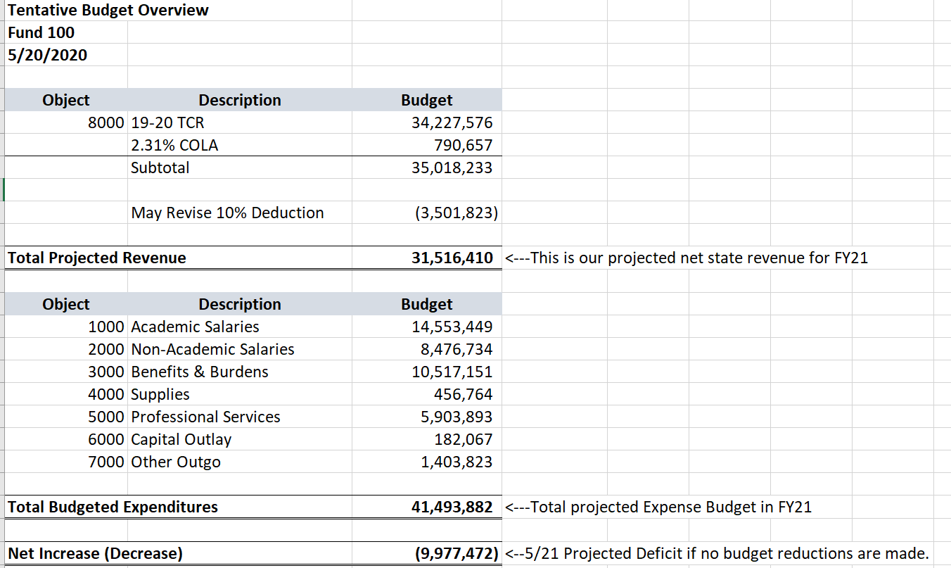

Slide 63
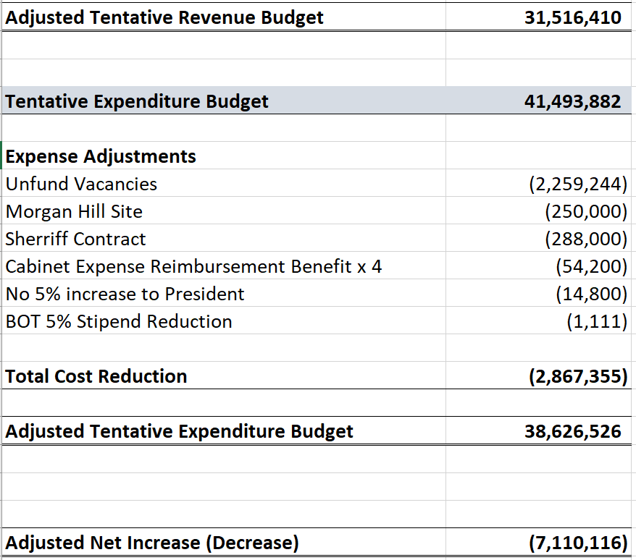
PHASE 1 Reductions (Proposed)

Slide 64
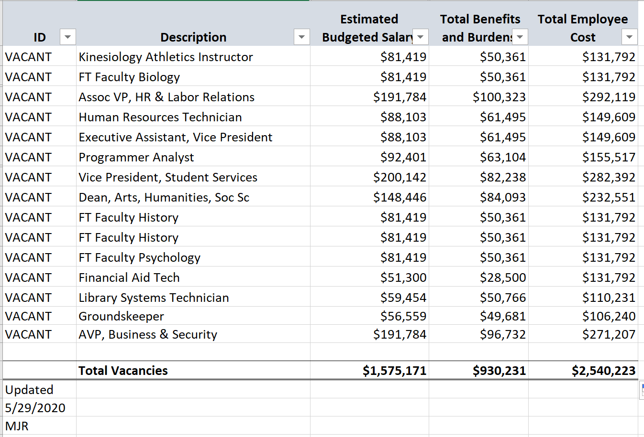
Phase 1: Proposed Defund of Vacant Position
Most Current Position Vacancy List as of 5/29/20

Slide 65
Governor’s Update 5/7/20
One Year Ago:
  $21B Projected Surplus to help secure California’s financial
  Record low unemployment
  Highest bond rating
Projected FY21 (90 Days Ago)
  $6B Projected Surplus to add
  20-month consecutive job growth
Today:
  Department of Finance: Projecting “Tens of Billions” of shortfall ($54B)
  $11.9B Unemployment – March 15
  Manageable if Federal Government helps California because California is 6th largest economy

Slide 66
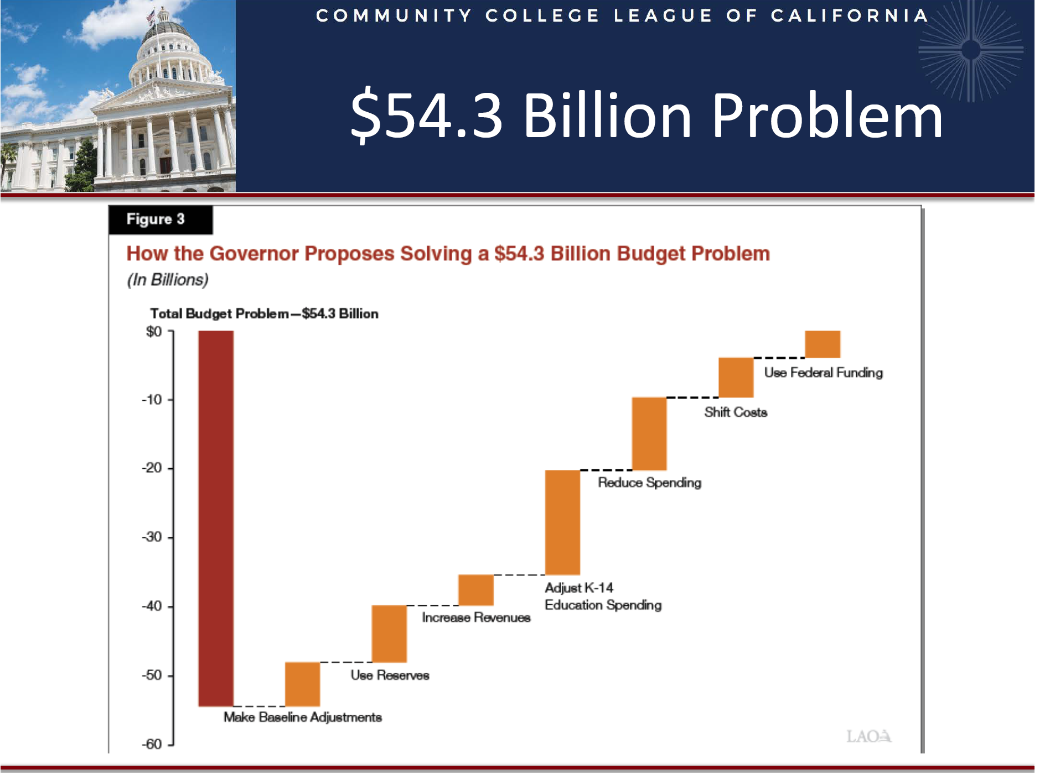

Slide 67
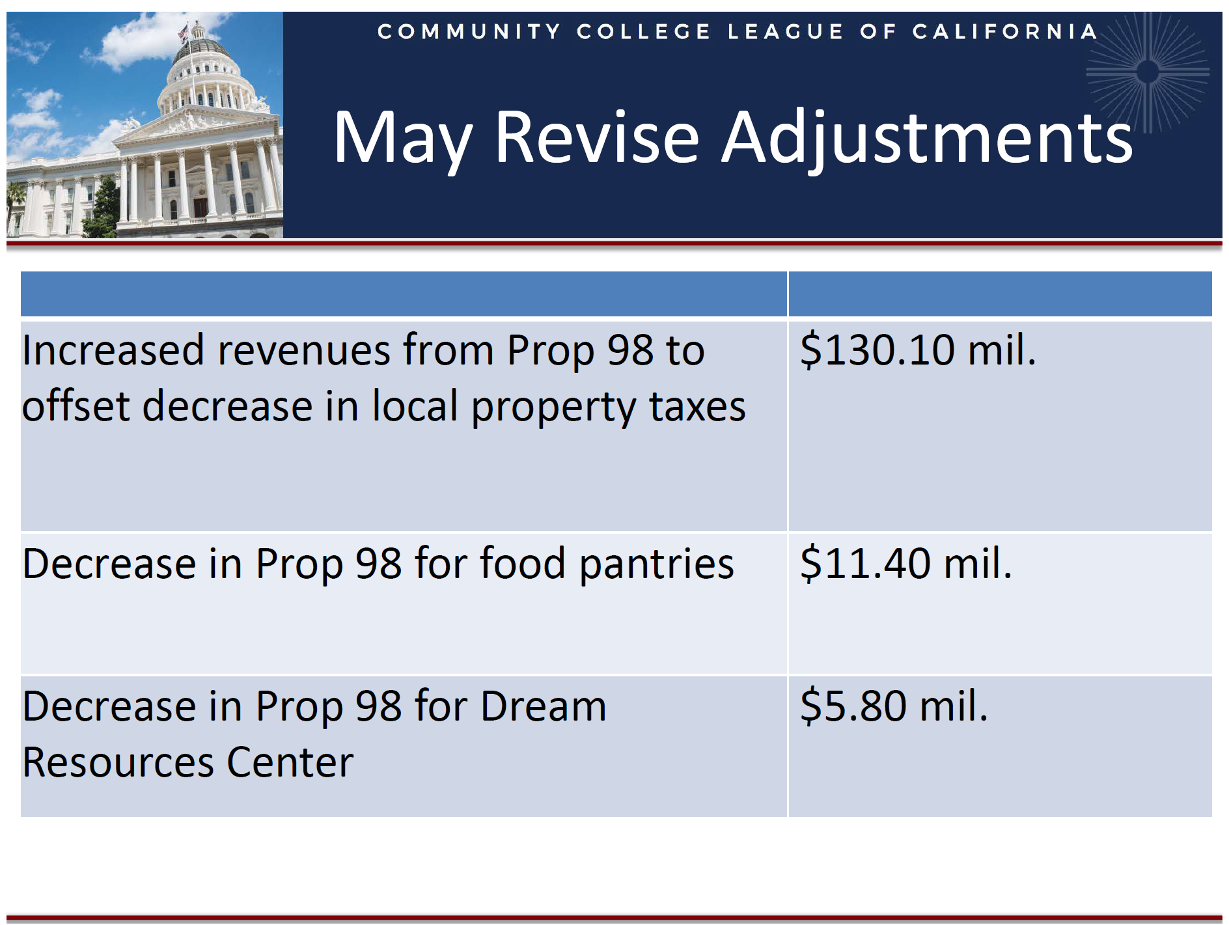

Slide 68
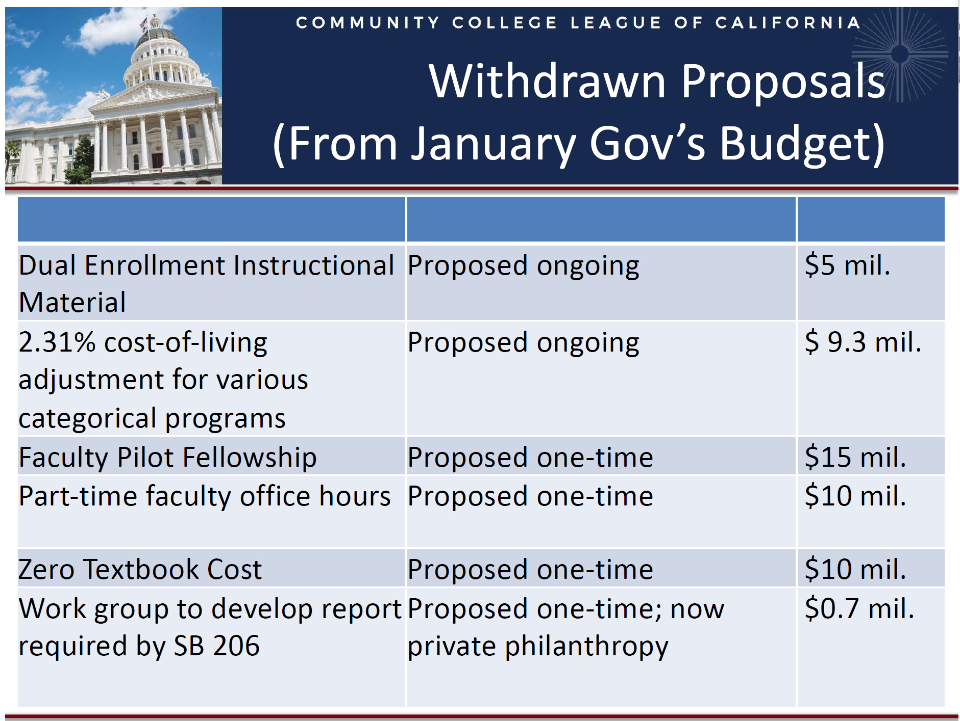

Slide 69
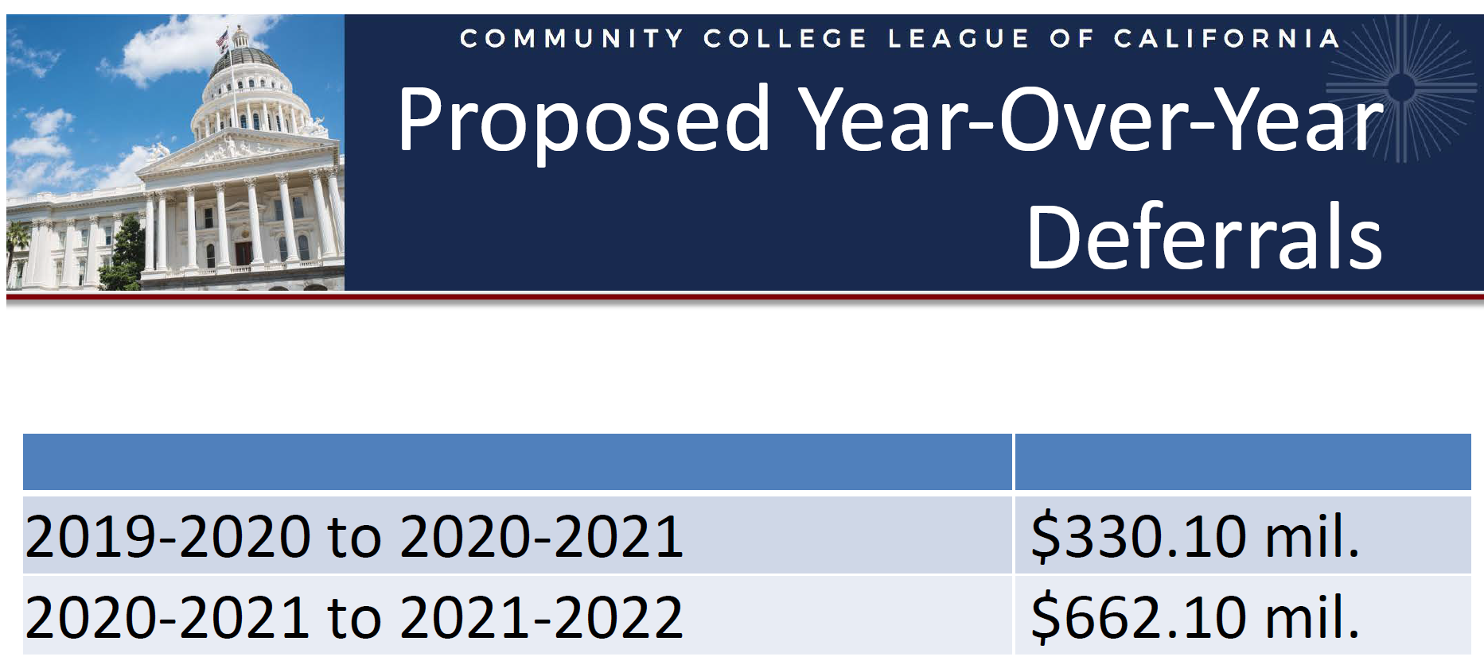

Slide 70
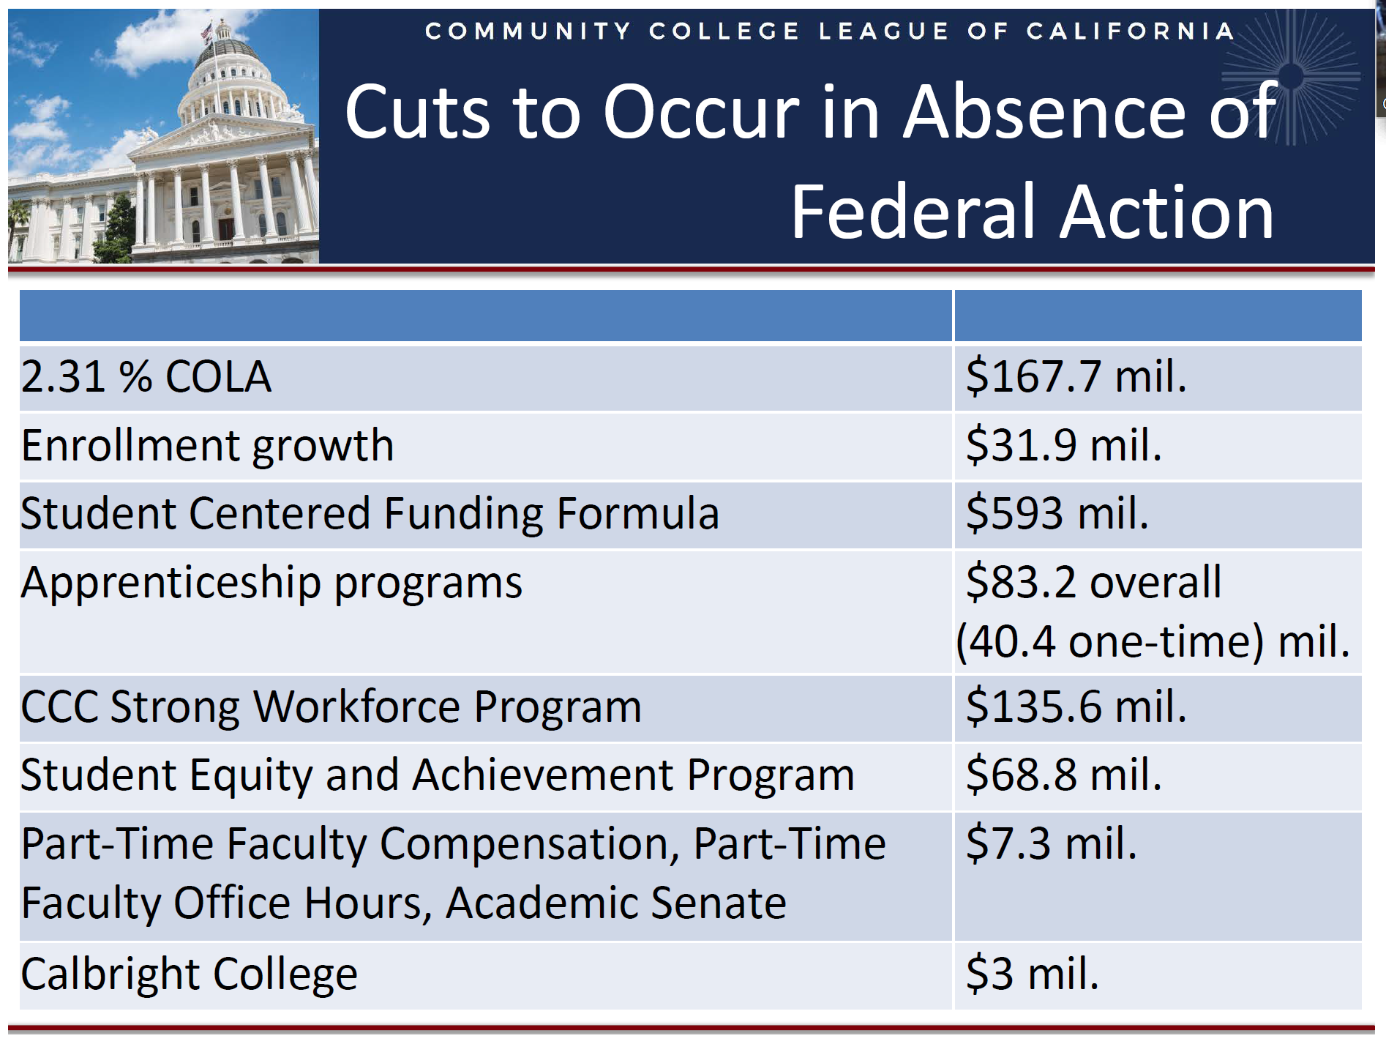

Slide 71


Slide 72


Slide 73


Slide 74


Slide 75


Slide 76

SERP SAVINGS

Slide 77


Slide 78
SLIDES FROM APRIL 2020 (& PRIOR)

Slide 79


Slide 80

3/31/20 Book Value:
$5.8M
5/31/20 Book Value:
$6,506,562

Slide 81
Recommendations for FY20 Closeout
Seek Utilities from South Bay Academy - $200K
Seek Reimbursement from OPEB - $1M to $1.2M
Seek Reimbursement from unanticipated COVID related expenses - $?
TOTAL: $1.2M - $1.4M (Before Revenue Deficit Coefficient)

Slide 82

Budget Calendar FY21

Slide 83
Current Fund Balance Estimates
General Fund
If OPEB is reimbursed:
  FY20 Fund Balance: $2,117,549 (5.75% Fund Balance)
If no OPEB Action:
  Year End FY20 Fund Balance: $617,549 (~1.6% Fund Balance)
FY20 Revenue Deficit Coefficient – Undecided
July Board – Need a $10M TRAN (estimated)

Slide 84
FCMAT – Fund Balance & Reserve for Economic Uncertainty
https://www.fcmat.org/PublicationsReports/Community-College-FHRA-4-14-2020.xlsx
11.1 Does the district have at least a 5% Reserve for Economic Uncertainty in the current year?
11.2 Did the district’s adopted budgets for the subsequent two years include at least a 5% Reserve for Economic Uncertainty?
11.3 Does the district have at least a 5% Reserve for Economic Uncertainty in its budget projections for the two subsequent years?
11.4 If the district’s budget projections for the subsequent two years do not include at least a 5% Reserve for Economic Uncertainty, does the district’s multiyear fiscal plan include a board-approved plan to restore at least a 5% Reserve for Economic Uncertainty?
11.5 Is the district’s projected unrestricted general fund budget stable or increasing in the two subsequent fiscal years?
11.6 If the district has unfunded or contingent liabilities or one-time costs, does the unrestricted general fund balance include any dedicated reserves above the recommended minimum 5% reserve level?

Slide 85
FCMAT - Cash Management
4.1 Does the district balance all cash and investment accounts with bank statements monthly?
4.2 Are outstanding amounts in the cash and investment account reconciliations less than one year old, or if older, have a resolution?
4.3 Are accounts held by the county treasurer reconciled with the district’s and county office of education’s reports monthly?
4.4 Does the district comply with its county treasurer and/or county office of education’s requirements for balancing accounts?
4.5 Has the district had a positive cash balance at the end of the month during the most recent 12 months?
4.6 Does the district forecast its cash receipts and disbursements at least 18 months out, updating the actuals and reconciling the remaining months to the budget monthly to ensure cash flow needs are known?
4.7 Does the district have a plan to address cash flow needs during the current fiscal year?
4.8 Does the district have sufficient cash resources in its other funds to support its current and subsequent two fiscal years’ projected obligations in those funds?
4.9 If interfund borrowing is occurring, does the district comply with Object Code 7300 requirements in the BAM?
4.10 If the district is managing cash in any funds through external borrowing, such as a TRANS, has the district set aside funds for repayment attributable to the same year the funds were borrowed?

Slide 86

MH Lease & ROI
Lease:
https://gavilan.sharepoint.com/:b:/g/gavilandocuments/EVlPwWAjk5VFl_GyR9HbJpcBQBzaCZs9QZXFhZ3ODHaxww?e=iC03wm

Slide 87
SC Sheriff Contract
Responding to disturbances on the Main campus, campus parking lots or other areas of the facility.
Facilitating reporting in support of criminal investigations related to Gavilan law enforcement activities.
Keeping order and peace throughout campus.
Provide security and maintain order at meetings, hearings, rallies, sporting events, other gatherings, and supplemental coverage within shift or with the prior approval of the Assigned Deputy's Unit Commander.
Observe and report public safety problems, safety, hazards, and other matters which require further attention by Gavilan.
Participate in administrative hearings including but not limited to campus security staff, board and shared governance committee meetings as directed by Gavilan, with prior approval from the assigned Deputy's Unit Commander.
Enforce parking regulations, issue citations; Impound vehicles & Provide crime statistics.
Assist the development of response plans for college disturbances and emergency situations.
Provide input in developing a formal campus crime prevention program.
Assist the in the development of programs and procedures for students and staff regarding safety and security issues.
Critical incident and specific crime information shall be provided to Gavilan by the Sheriff's Public Information Officer.
10.8 months of each calendar year; Assigned Hours of Coverage: 7:30AM until 3:30PM, Monday through Friday
FINAL - AGREEMENT CNTY OF SANTA CLARA SHERIFF.docx

Slide 88
CARES Act
CARES Act Committee met twice
  Principles and Values of the allocation for the direct aid to student and most need.
50% $1.1M for direct student aid
  832 students that are qualified.
  $700 awarded to each student
50% $1.1M for institutional support directly related for the COVID response
  Some tech improvements to faculty and staff
  PD for faculty for DE

Slide 89


by Mark Schniepp May 1, 2020https://californiaforecast.com/author/californiaforecast/

Slide 90


Slide 91

by Mark Schniepp May 1, 2020https://californiaforecast.com/author/californiaforecast/

Slide 92

by Mark Schniepp May 1, 2020https://californiaforecast.com/author/californiaforecast/

Slide 93

by Mark Schniepp May 1, 2020https://californiaforecast.com/author/californiaforecast/

Slide 94


Slide 95

Notes:
Overages are from:
Include Overload + Dean + Additional Inst Assign (will need to be reset in FY21)
Primary from OT related to IT Staff and insurance reimbursement is pending
ncludes $800K + 335K

Slide 96
CCCCO & League
FY21 Assumptions & Updates
Chancellor Oakley:
  May revise will occur on Thursday, final determined in August.
  $18B impact on K-14 schools (Prop 98).
  All 115 colleges should expect reductions in general apportionment & categoricals.
  Emphasizing flexibility; focus on trying to maintain current levels of enrollment.
  No certainty for a rebound in FY21 and the recovery timeline.
  The Re-Opening Task Force has been created by the CEO group that will be providing preliminary findings and guidance will be available May 22nd.
The Community College League of California is advocating for the following:
  Protect the base funding.
  Maximize local flexibility.
  All 115 colleges share in the reductions equally.
  Extend the “hold harmless” for two more years.
  Provide regulatory relief to promote stability.
  Evaluate the Student Centered Funding Formula in lieu of remote instruction.
  Consider security measures for all districts.

Slide 97
Update from Emergency Operations Center from Ryuk & COVID.
  $25K deductible per occurrence.
  FEMA reimbursement eligibility & process (typically 2-year lag)
Fiscal Update of Gavilan Joint Community College District
  FY20 Expense Projection* & Unforeseen factors
    December 2019 - $1.9M deficit
    January 2020 – changed to $1.7M deficit
    February 2020 (after State Recalculation) - changed to $3M deficit
  FY21 Revenue Projections
    No COLA in FY21
    Property Tax deference
    JPA
    Golf
  FY21 Expense Reduction Recommendations
    Morgan Hill Site Rental
    Potential personnel changes
    OPEB (expense reimbursement, to help balance FY20 before FY21) $1M
    Other potential recommendations

