Slide 1
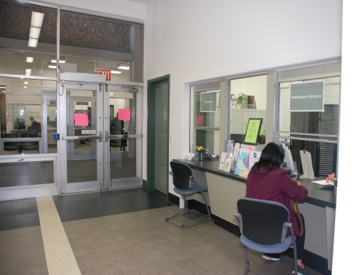
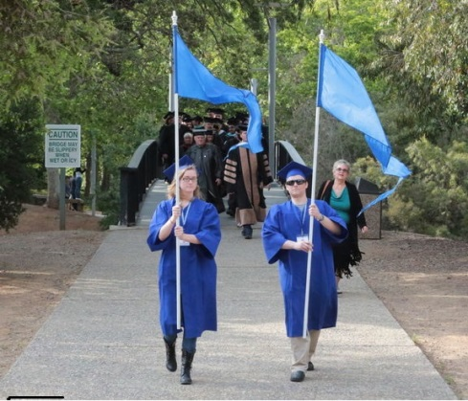
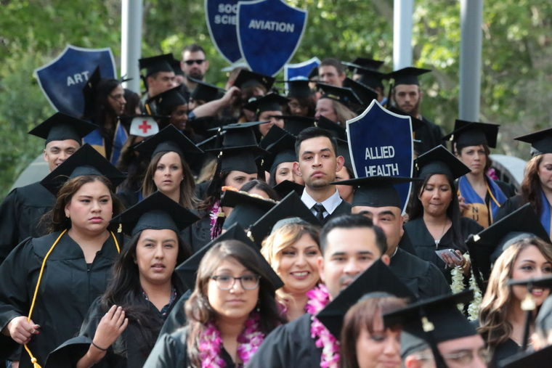
Gavilan Joint Community College District Budget Committee August 28, 2018
Board of Trustees
Jonathan Brusco – President
Mark Dover - Vice President
Walt Glines – Clerk
Kent Child - Trustee
Lois Locci, ED D.- Trustee
Rachel Perez– Trustee
Laura Perry - Esq. – Trustee
Adam Lopez - Student Trustee
Administration
Dr. Kathleen A. Rose — Superintendent/President

Slide 3
FY 2017/18
• Shift $2.6 million in employee health premium costs from the General Fund to OPEB
• OPEB trust currently has $8.6m invested with a current liability of $12m
• This OPEB shift will ensure compliance with the 50% law
• Shift $115,000 in expenses from the General Fund to the Parking Fund
• Shift $275,000 in legal, lawsuit settlements and property & liability insurance expenses to Self-Insurance Fund

Slide 5
FY 2018/19
• Reduced $65,000 from 1310 account and $12,000 in faculty overload General Fund
• Implement the Enrollment Management Plan to scale to achieve the following efficiencies. Overall implementation should yield a reduction of at least $300,000 in ongoing staffing costs to meet current FTES projections.
Salaries Moved to Parking Fund in 2017-18 remain there $115,000.

Slide 7
FY 2018/19 Additional
Add 197 FTES to Revenue equal to $1 million.
Decrease the 1310 and 1350 Accts $485,000.
Hold additional vacancies $500,000.
Business Office Positions $97,424.
Benefits reduced related to above $340,547.
Reduce contracts $200,000 out of $7 million.
Transfer additional expenses $100,000 to Capital Fund out of General Fund.

Slide 10
FY 2019/20
• Research and analyze a Supplemental “Executive” Retirement Plan (SERP) option.
• Will need to be in place by January 2019 to realize savings in 2019/20
(Hand Out Available)

Slide 11
Next Steps Needed
Committee approval to move forward to September Board for action and information.
a) Resolution to reimburse medical costs for $2.6 million 2017-18 expenditures.
b) Approve 2018-19 Adopted Budget
c) Information Item to Board on SERP for FY 2019-20.
d) Mid-Year Review to come back to Board in January 2019.

